Slide 1


member of GEOSAN INVESTIČNÍ
We do BIG things

Slide 2
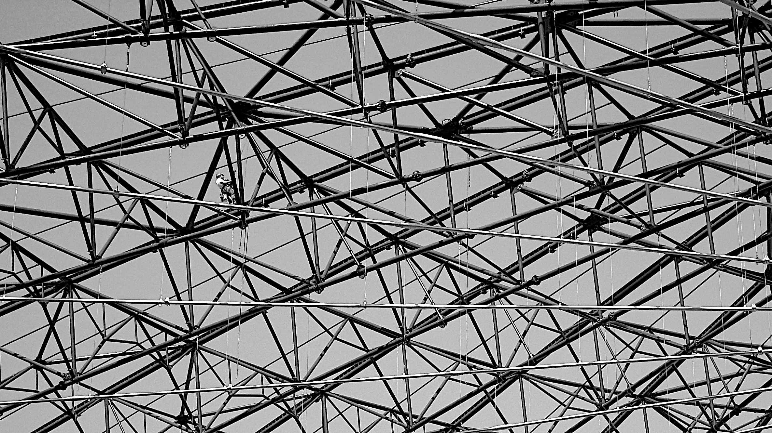
WHO WE ARE
Hutní montáže, a.s. is a company established since 1953 specializing in the installation of large investment units, their repair and maintenance, as well as the supply and installation of steel structures, bridges, and both pressure and non-pressure components of technological units, particularly in the energy sector, paper industry, worldwide. Additionally, we offer rental services for cranes and construction machinery.

Slide 3
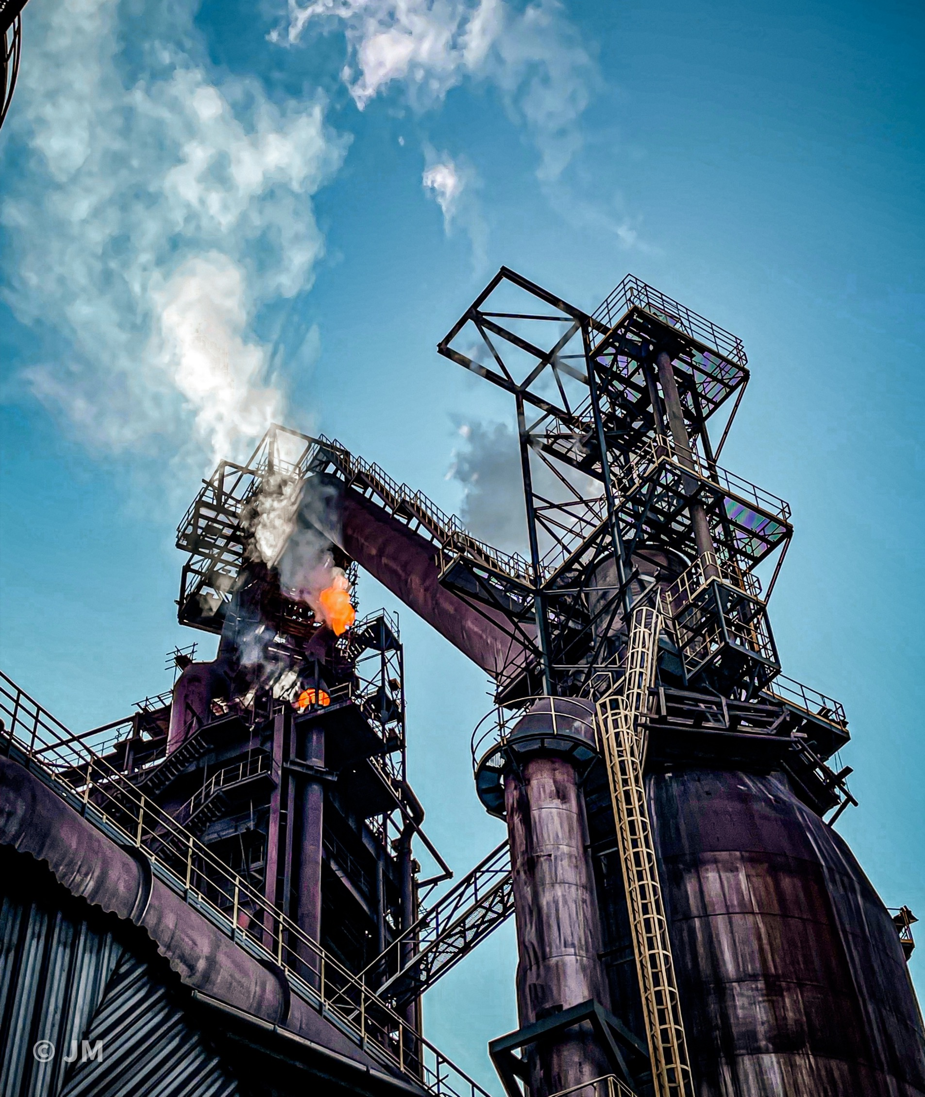
70 YEARS OF EXPERIENCE FOR THE TECHNOLOGY OF THE FUTURE
In addition to the domestic market, we are increasingly
focusing on the EU, especially Germany, the Netherlands, Slovakia, Finland, Sweden, Denmark, Portugal, and Poland,
as well as South Africa and South America.
Our annual revenue has been around 40 – 50 million EUR
in the last five years, with approximately 50% generated abroad. We have around 470 employees and cooperate with several skilled staff recruitment companies to expand our workforce when needed. This allows us to successfully implement large-scale construction projects worldwide.

Slide 4
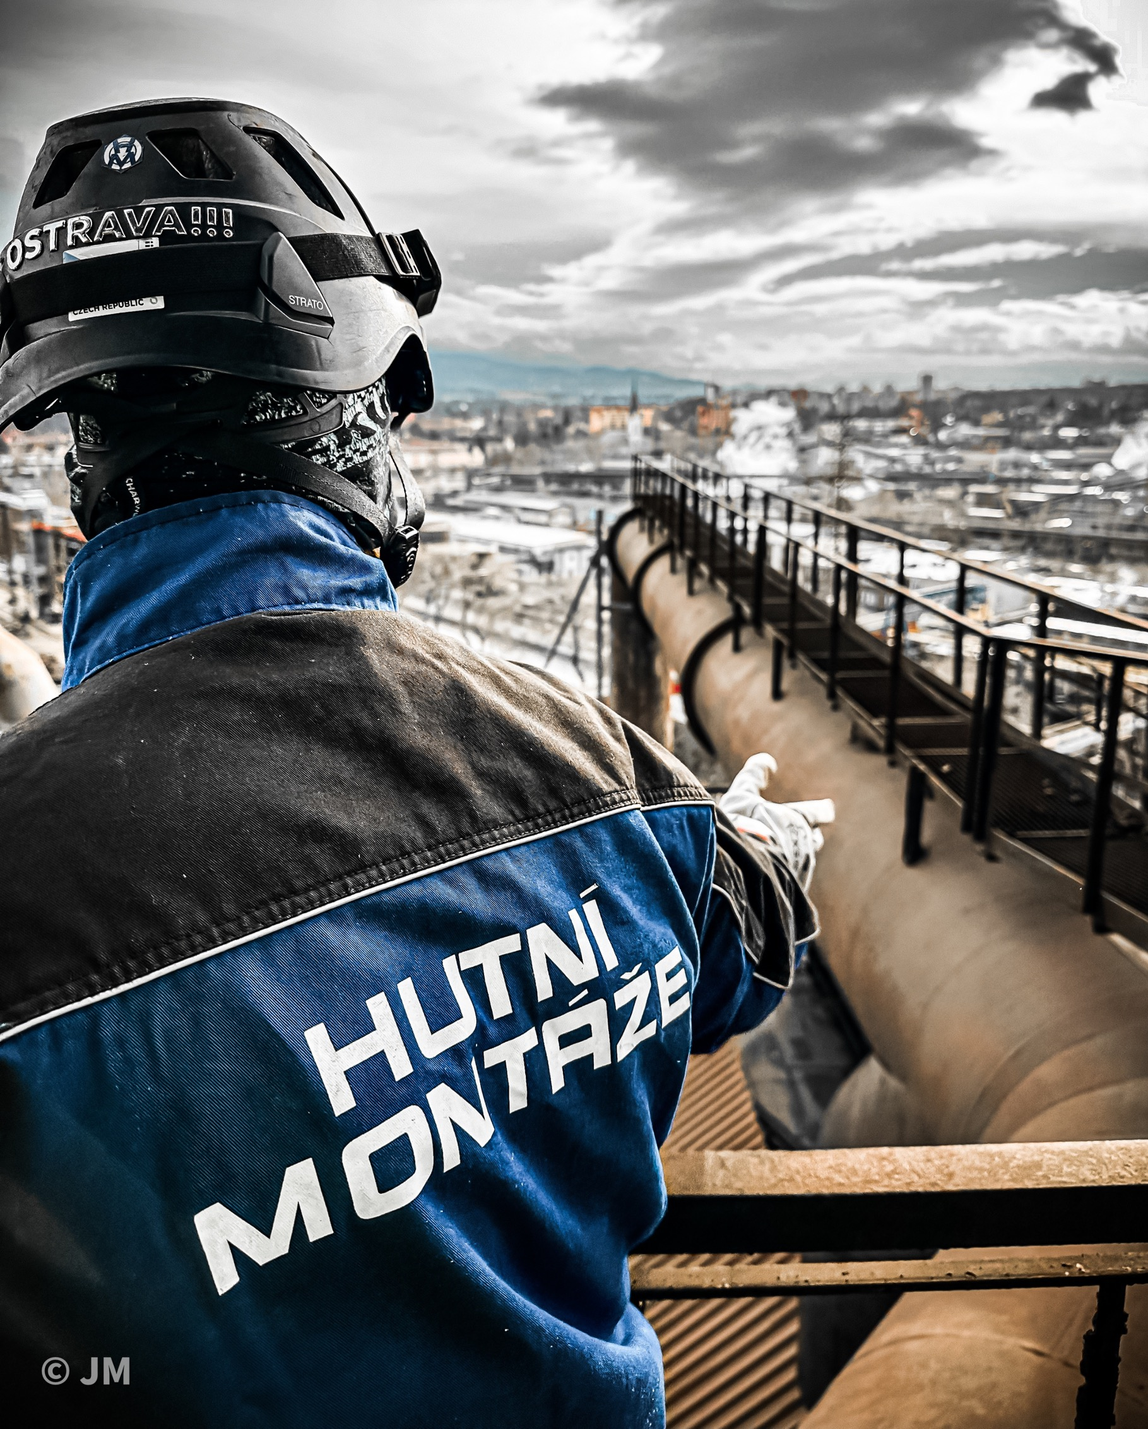
COMPANY REGISTRATION
The company is registered in the Trade Register kept by the Regional Court in Ostrava, File No. B 143
Company Reg. No: 15504140
VAT: CZ1550140
D.U.N.S. : 64-353-0207
Hutní montáže, a.s. is also registered in the following countries:
Czech Republic | CZ15504140
Sweden | SE5020626997301
Slovakia | SK2020336857
Germany | DE261236195
Finland | FI21789629
Uruguay | 215405000015
Luxembourg | LU34775330
Austria | 46 523/7345
Portugal | PT980810612

Slide 5
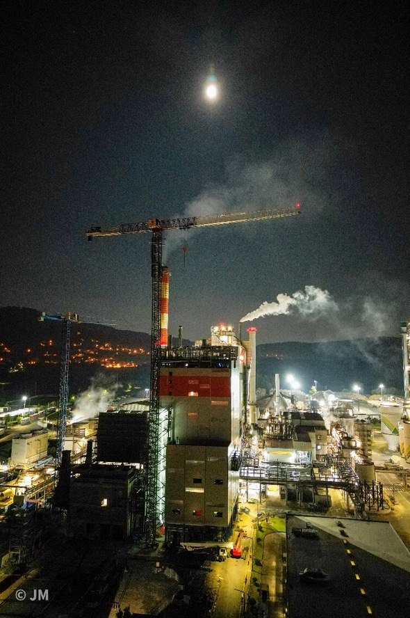
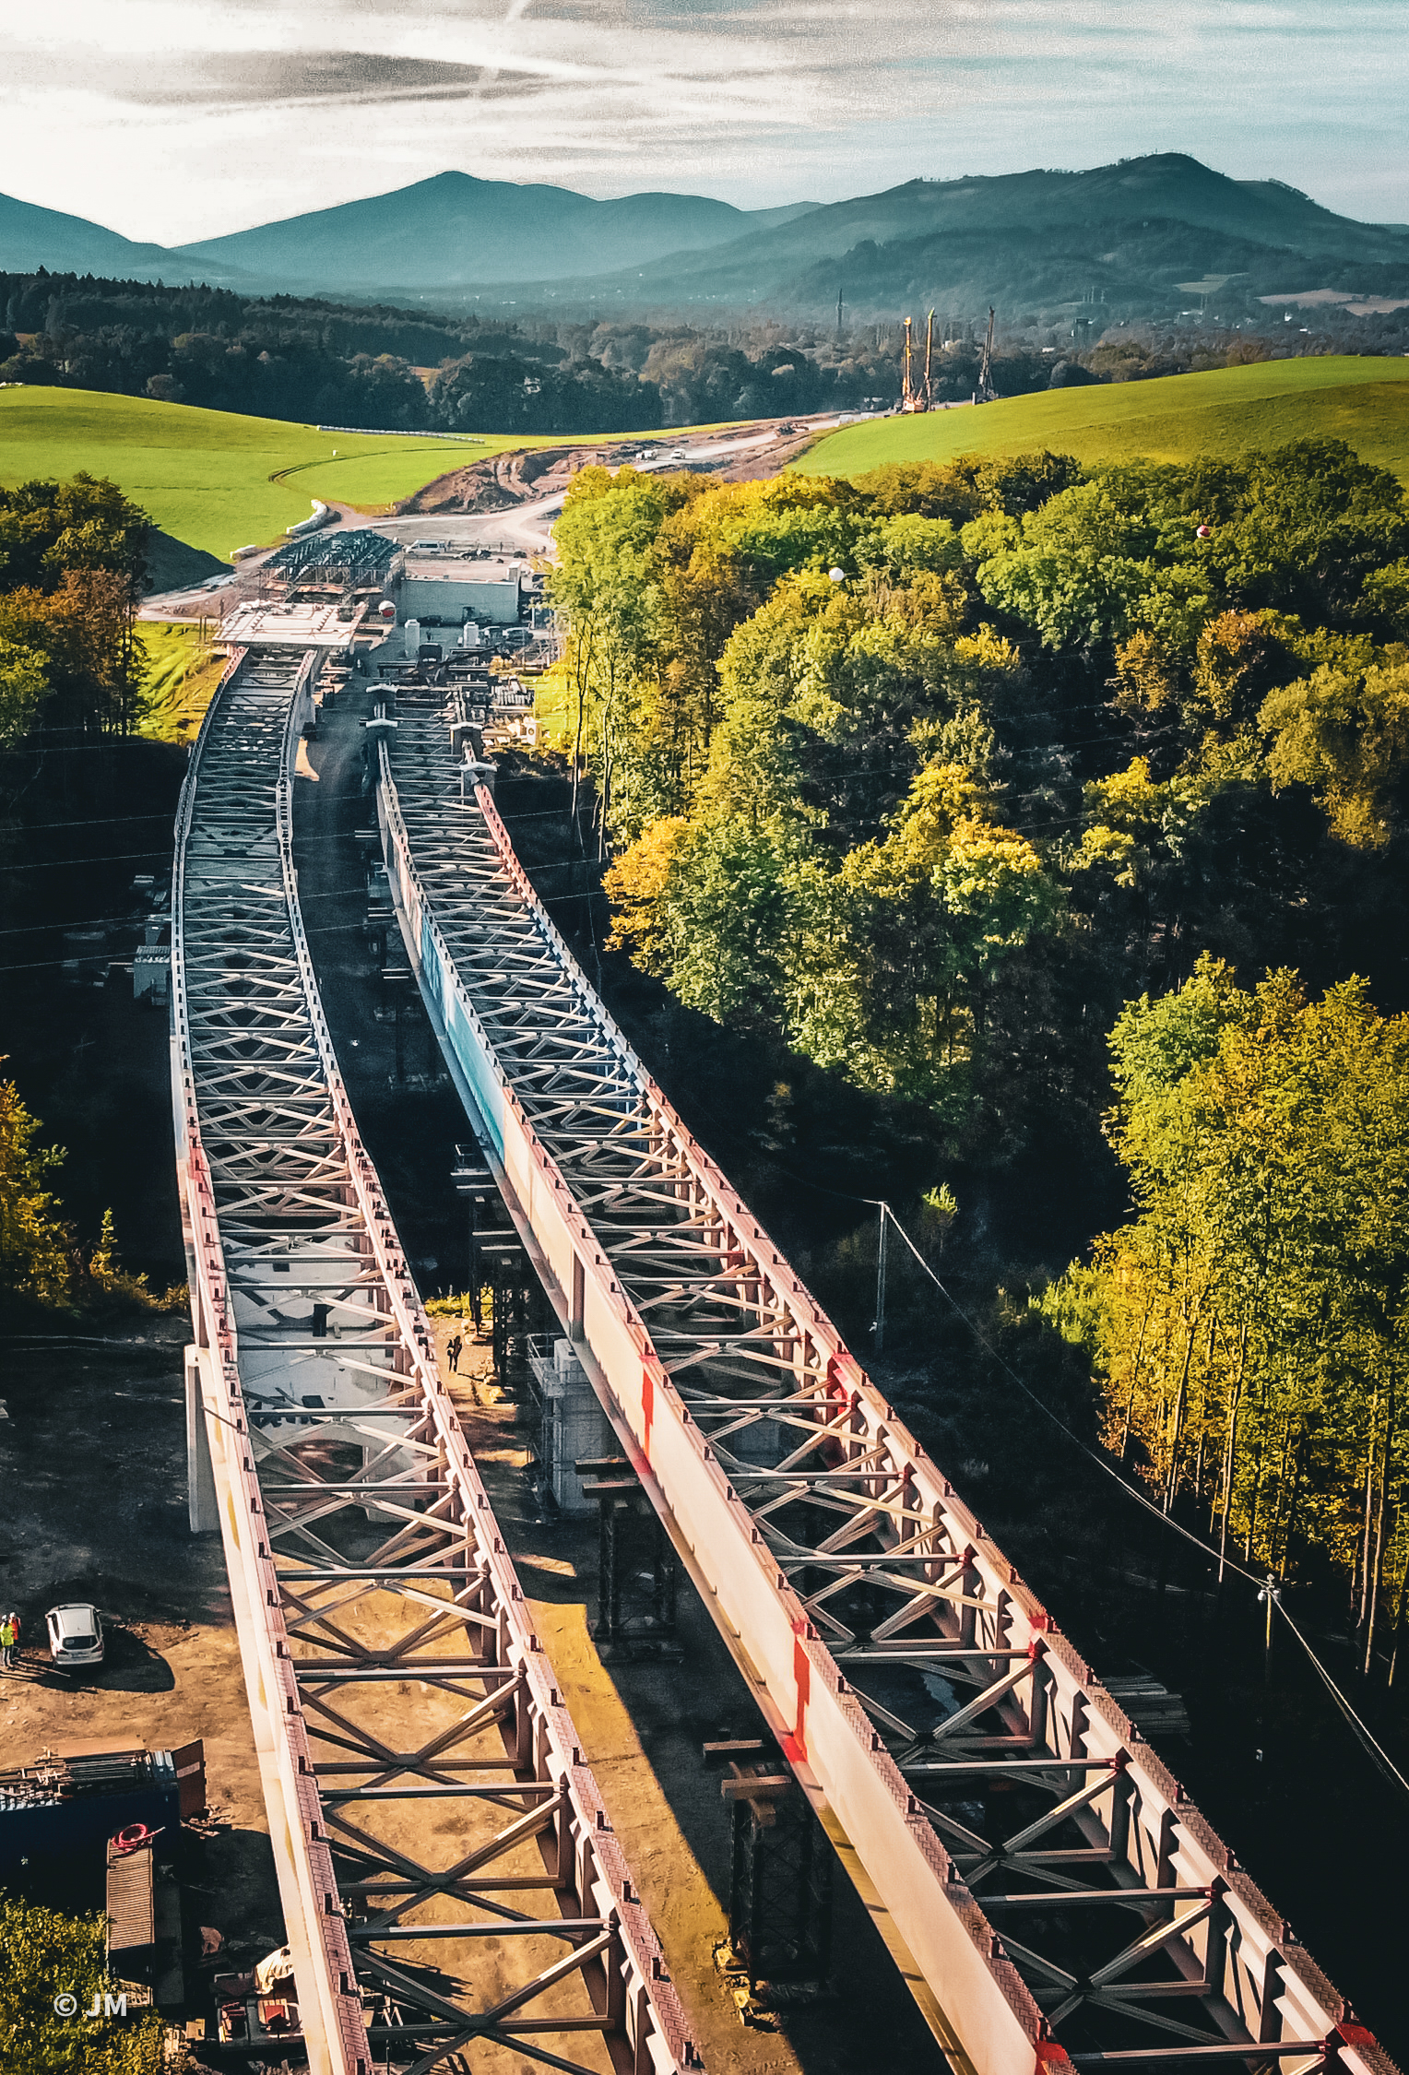
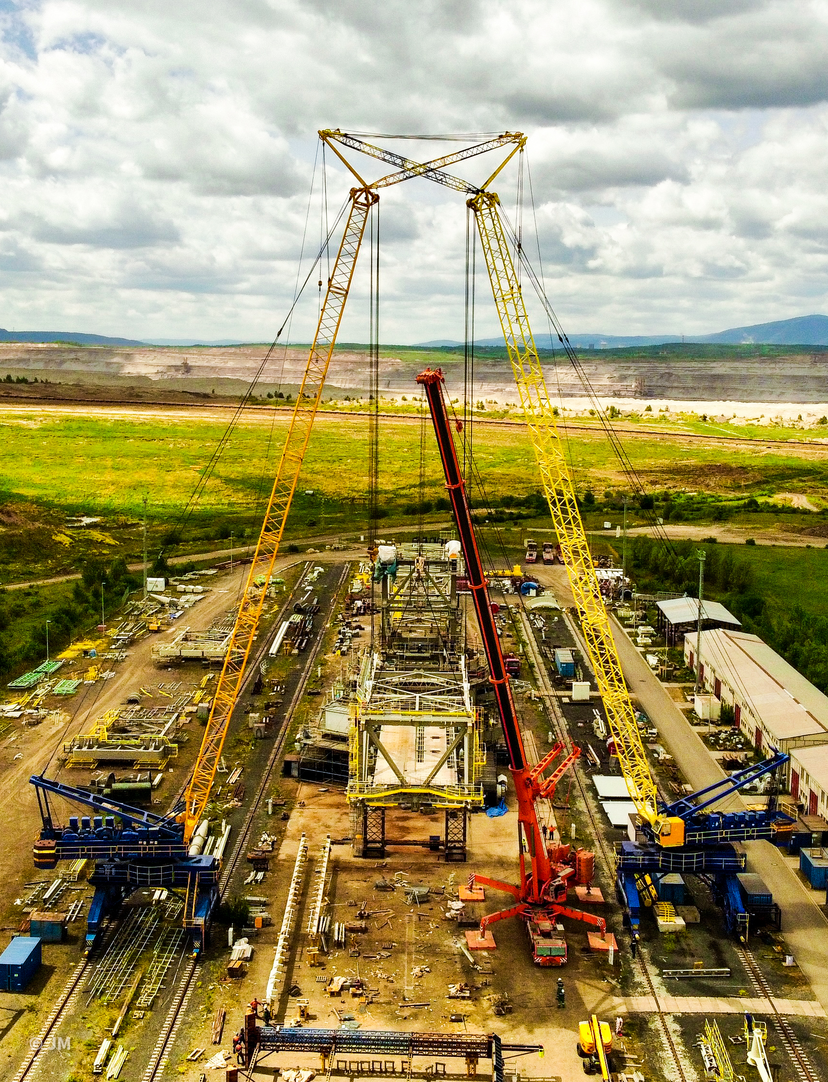
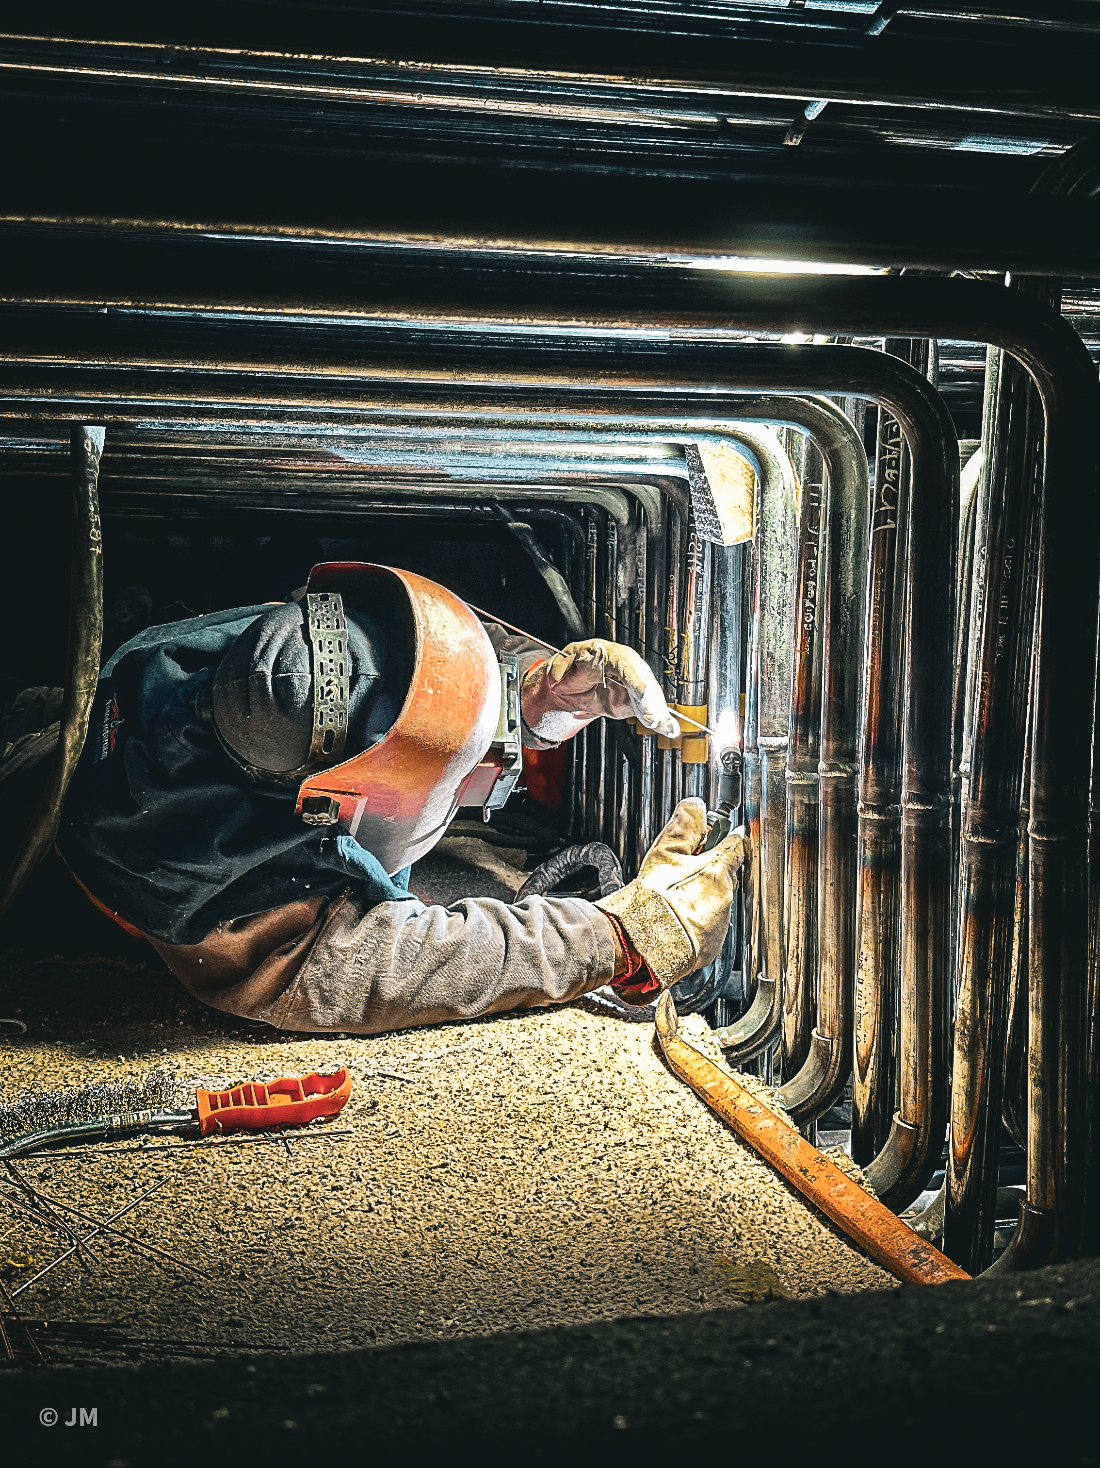
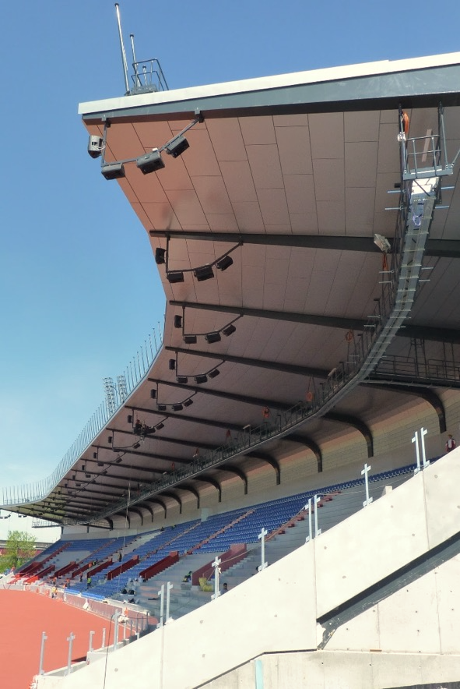
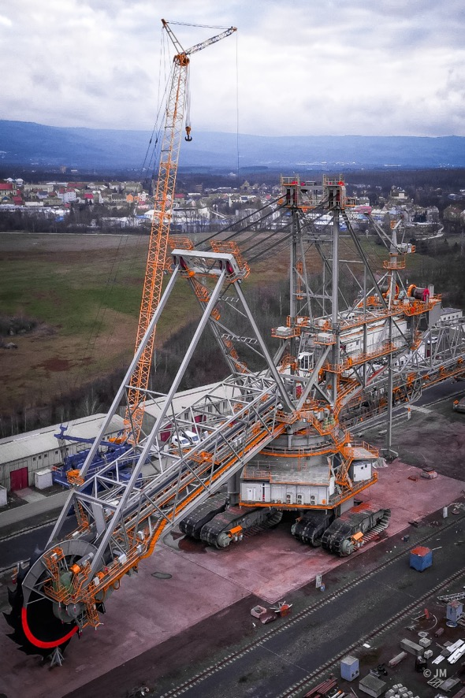
What We Do
WE DELIVER SMART SOLUTIONS THAT TURN YOUR IDEAS INTO REALITY
POWER AND PAPER INDUSTRY
BRIDGE STEEL STRUCTURES
CRANES AND MACHINERY
METALLURGICAL WORKS
INDUSTRIAL, SPORTS AND OTHER STRUCTURES
MINING INDUSTRY

Slide 6
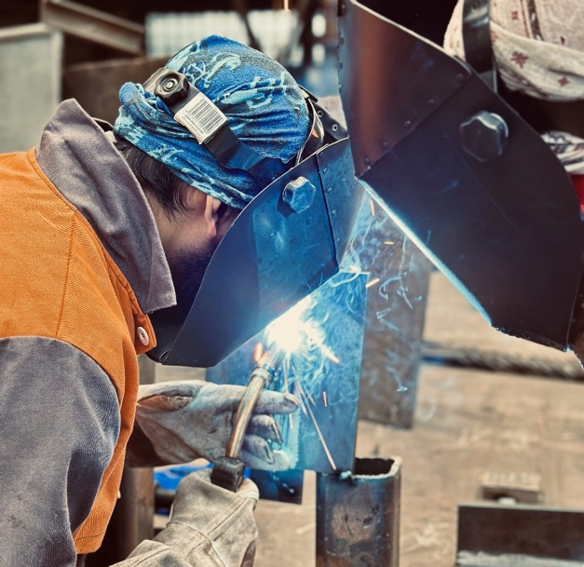
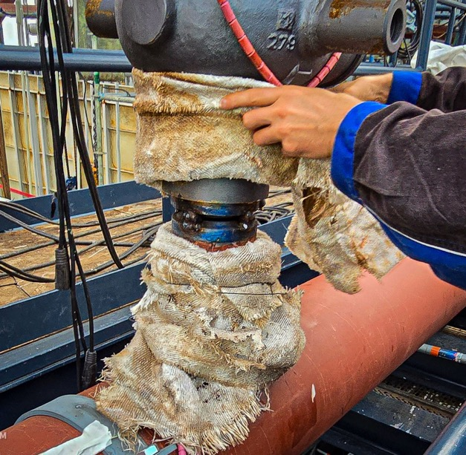
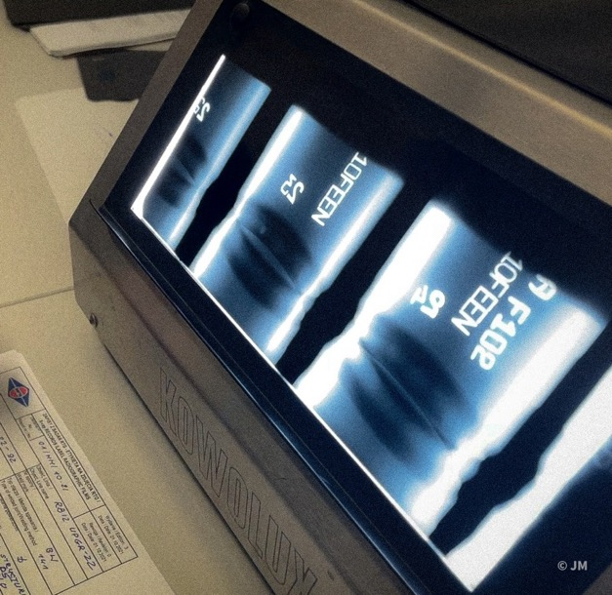
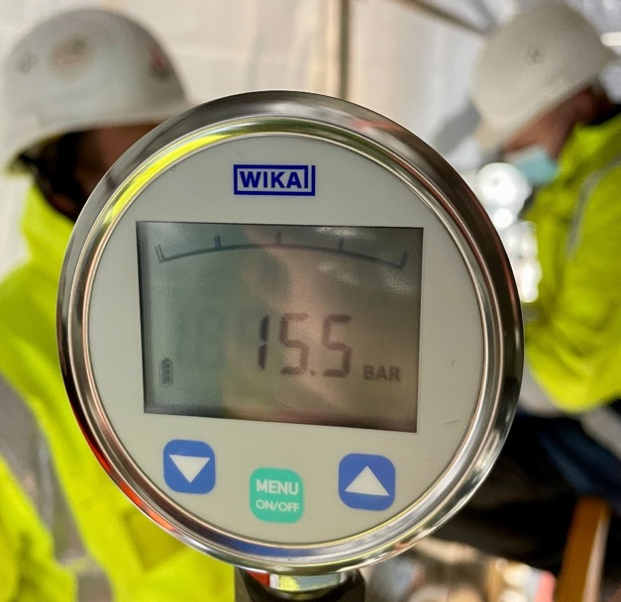
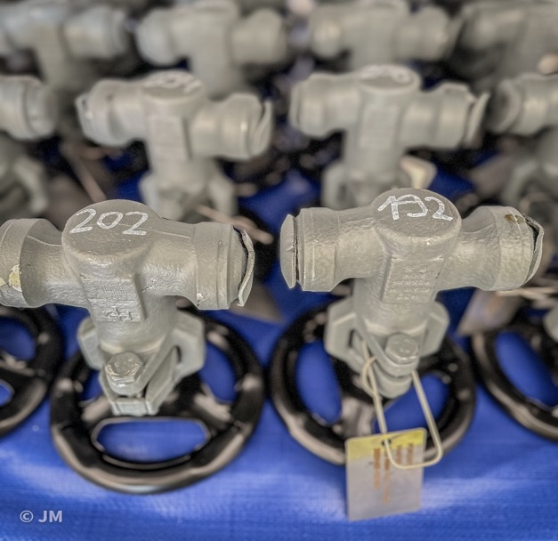
What We Do
COMPLEX SERVICES
WELDING
PREHEATING AND POST-WELD TREATMENT
MATERIAL HANDLING, STORAGE AND LIFTING
NON-DESTRUCTIVE TESTING OF WELDS
PRESSURE TESTING
111 Shielded Metal Arc Welding (SMAW)
121 Submerged Arc Welding (SAW)
135 Gas Metal Arc Welding (GMAW)
136 Flux Cord Arc Welding with Active Gas Shield
138 Metal Arc Active Gas Welding (MAG)
141 Tungsten Inert gas Arc Welding (TIG)
We provide specialized preheating and post-weld heat treatment (PWHT) services through our trusted suppliers.
We provide specialized NDT testing through our trusted suppliers.
We provide pressure testing services through our staff.
Material handling and storage is provided by our own staff. Equipment and cranes for any purposes are also managed by our company.

Slide 7
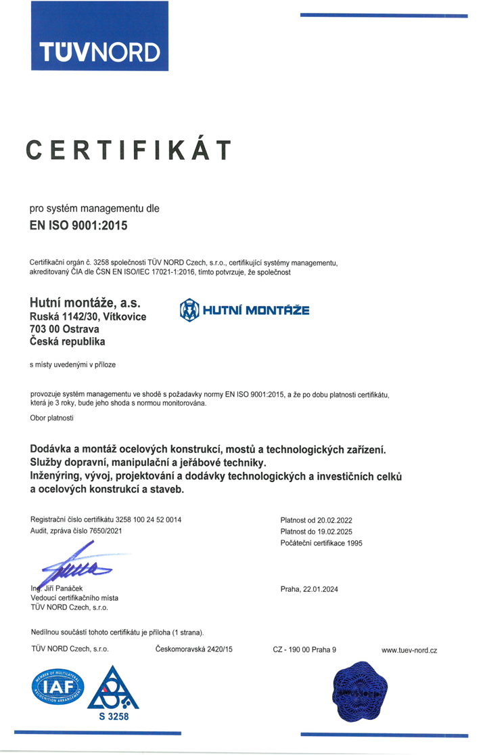
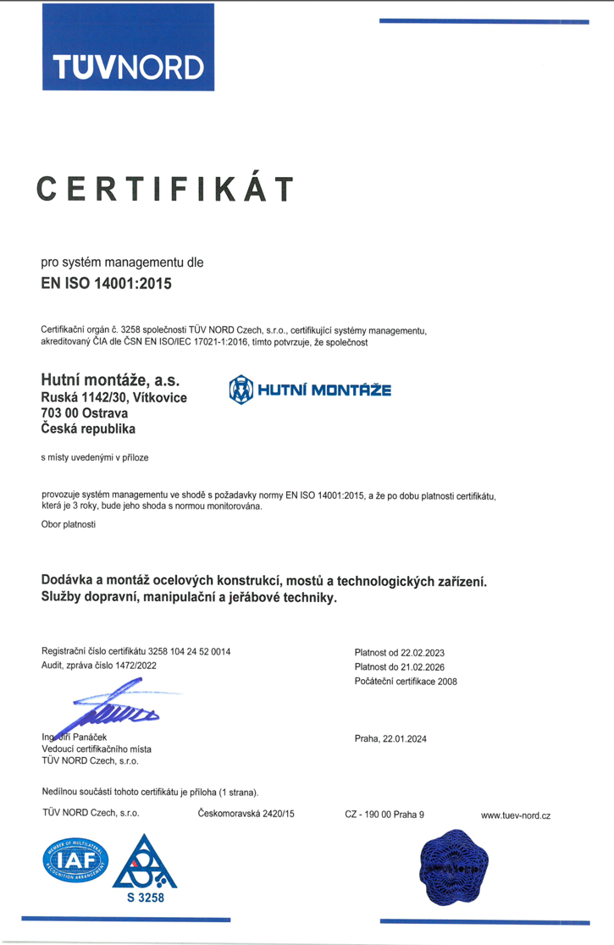
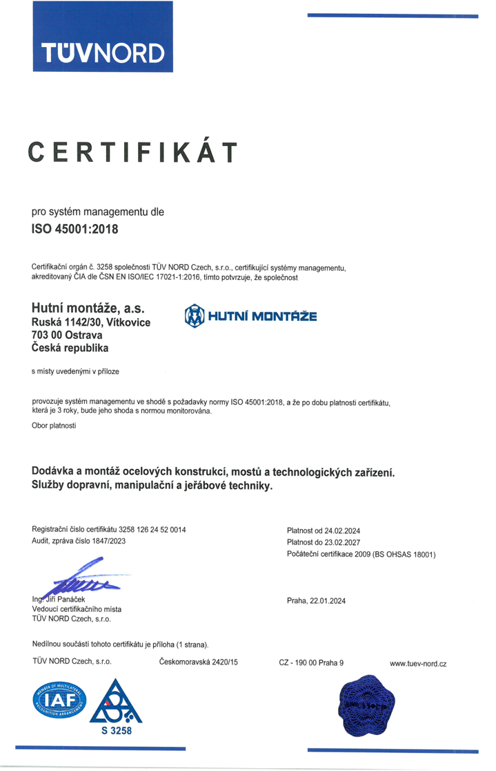
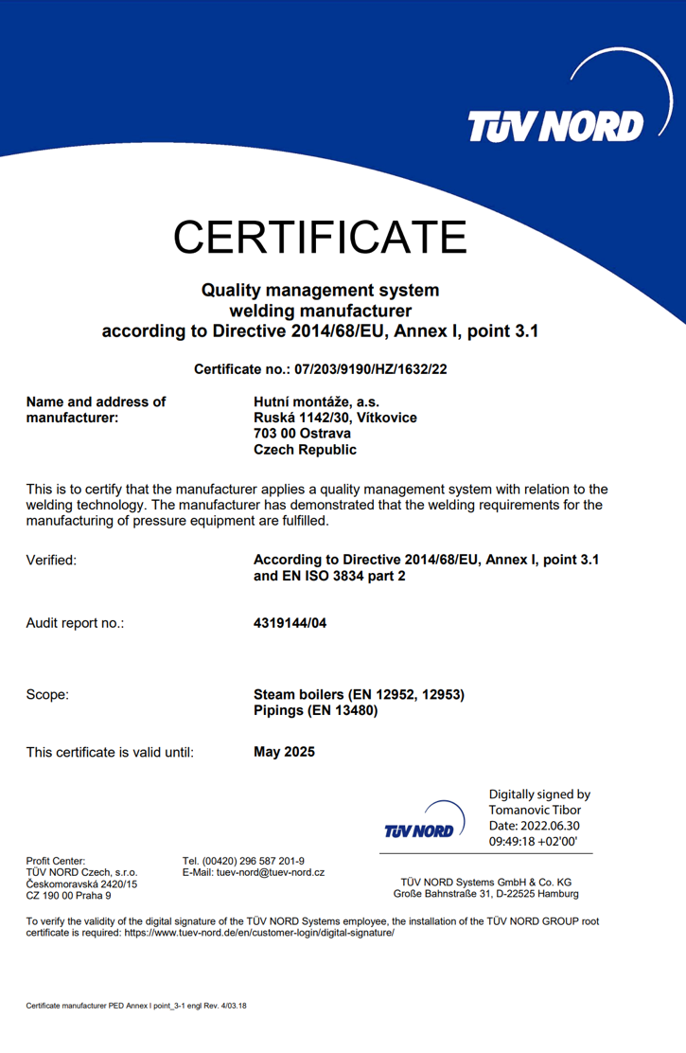
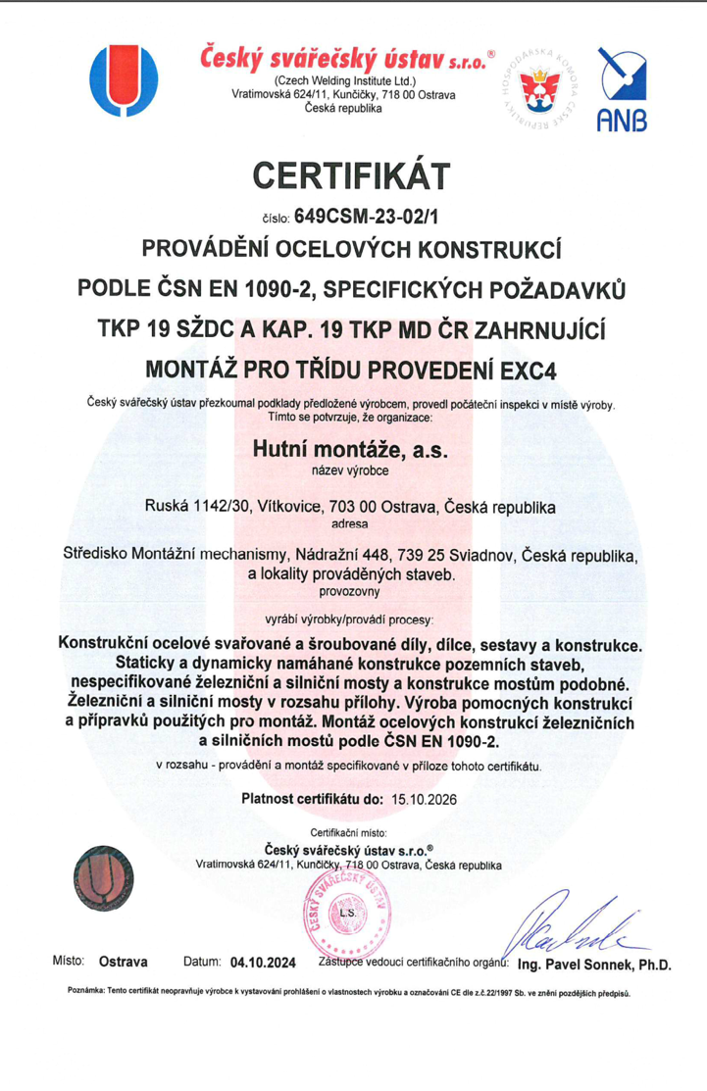
Certification
Certificates by TÜV NORD CERT: ISO 9001, 2014/68/EU (PED), EN 3834--2:2006, ISO 14001, ISO 45001 , AD HPO, TRD 100, TRD 201
Certificates by Czech welding institute: EN 1090-1/2

Slide 8

Certification and audits
Hutní montáže, a.s. have completed a comprehensive due diligence process (ESGmetrics) and undergone the Ethixbase 360 forced Labor & Human Trafficking: Risk & Regulation and Anti-Corruption Training

Slide 9
Corporate HISTORY and ownership structure
1953
1991
2013
2017
2025
1 january
9 march
1 DECEMBER
14 june
22 january
A national concern of Hutní montáže was established in Ostrava
A joint stock company of Hutní montáže, a.s., owned 100% by the state, was established
Vítkovice Heavy Machinery, a. s., became the minor shareholder of the company
Witkowitz GW, a.s. becomes the sole owner of Hutní montáže, a.s.
Hutní montáže, a.s. became part of Geosan Group, the sole owner being Geosan Pozemní stavby, a.s.

Slide 10
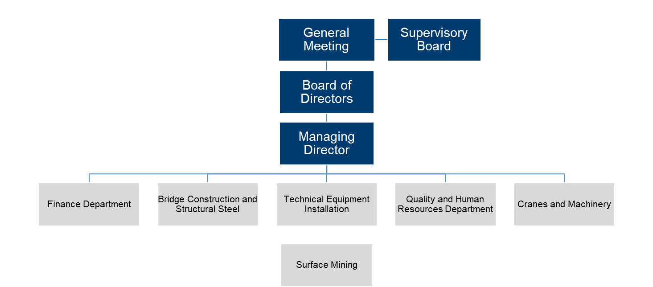
ORGANIZATION STRUCTURE AND MANAGEMENT

Slide 11
ORGANIZATION STRUCTURE AND MANAGEMENT
BOARD OF DIRECTORS
CHAIRMAN | Vladimír Bindzár
MEMBER | Robert Michura
MEMBER | Petr Brázda
COMPANY MANAGEMENT
MANAGING DIRECTOR | Vladimír Bindzár
EXECUTIVE DIRECTORS
FINANCE | Tomáš Hubička
TECHNOLOGICAL EQUIPMENT INSTALLATION | Robert Michura
BRIDGE AND CONSTRUCTION AND STRUCTURAL STEEL | Petr Brázda
HUMAN RESOURCES AND QUALITY | Jiří Mamica
CRANES AND MACHINERY | Marián Lastovica
SUPERVISORY BOARD
CHAIRMAN | Jiří Skuhra
MEMBER | František Vaculík
MEMBER | Vladimír Jurošek

Slide 12
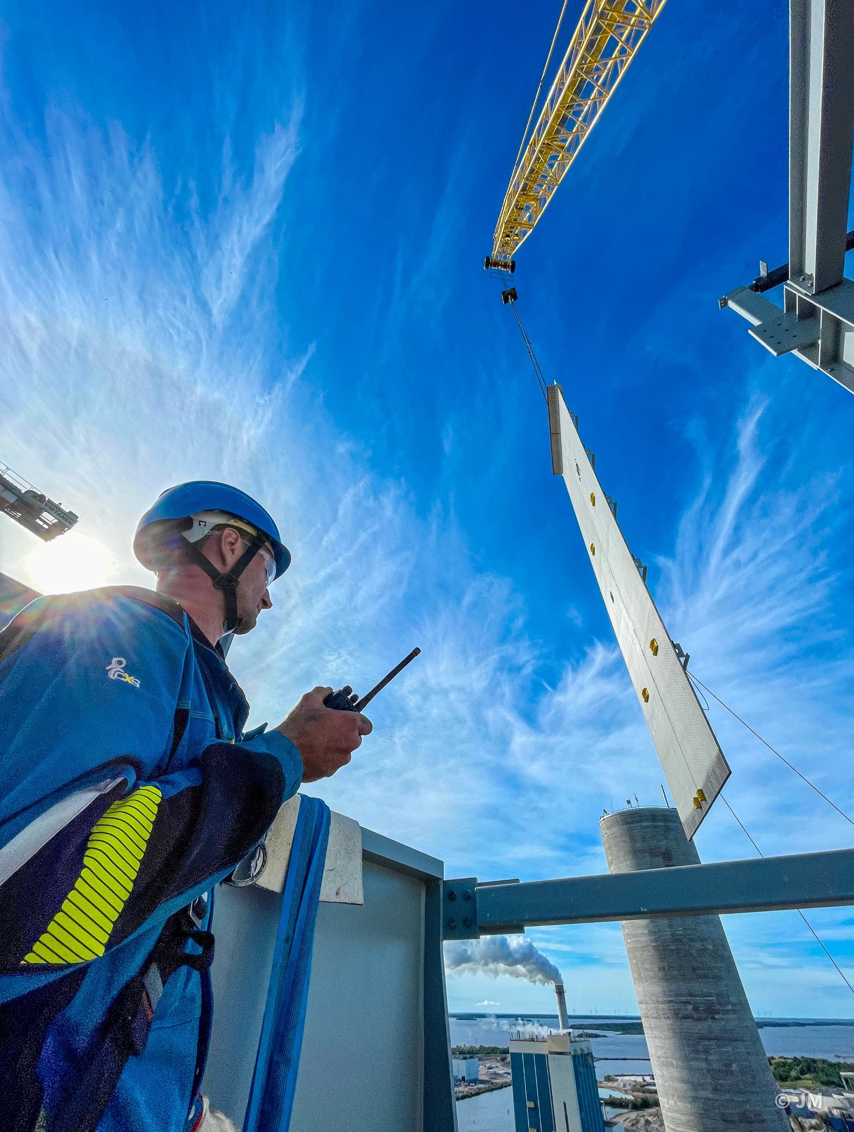
DIVISION OF
TECHNOLOGICAL EQUIPMENT INSTALLATION
PROJECT REFERENCES
Boiler Systems
Waste Incineration & Environmental Technologies
Energy & Water Infrastructure
Metallurgy & Industrial Plants
Surface Mining

Slide 13
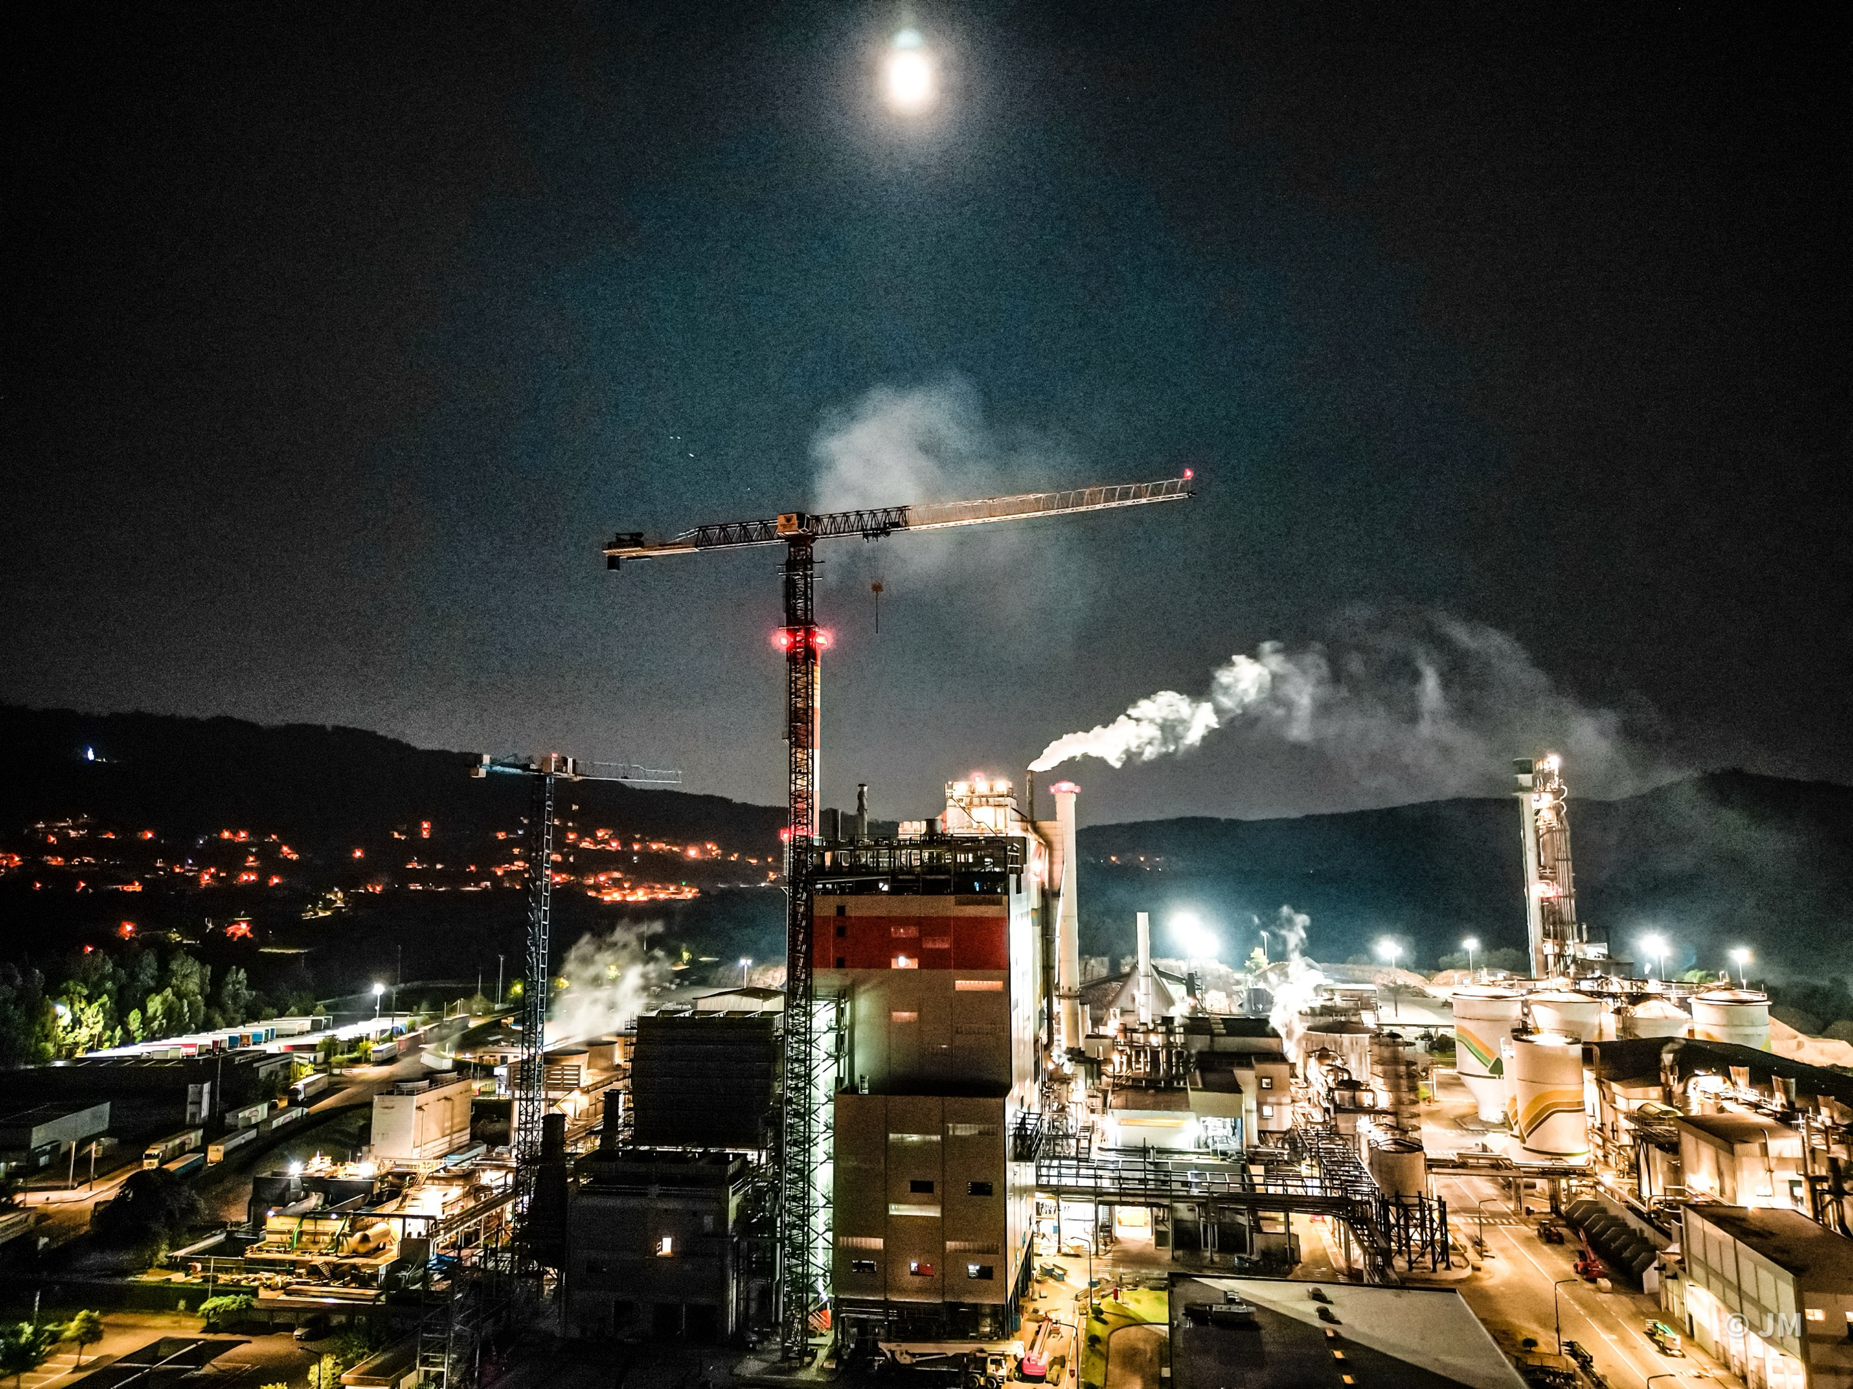
TECHNOLOGICAL EQUIPMENT INSTALLATION
Jan 2024 – Dec 2024
DSS VIANA RBO
RECOVERY BOILER 950 TDS/D INSTALLATION
Hutní montáže, a.s. installed a recovery boiler for Valmet Technologies Oy at the DS Smith Viana Paper Mill in Portugal. The company handled the installation of the boiler’s pressure and non-pressure parts, HP piping, equipment, and ducts. One of the most advanced in Europe, the boiler will boost the mill’s steam efficiency by 25%, recycling steam back into the process. With Valmet’s Electrostatic Precipitator, it ensures efficient dust removal and low emissions, supporting DS Smith's goal to cut CO₂ emissions and reach Net Zero by 2050.
VALMET TECHNOLOGIES OY
VIANA DO CASTELO, PORTUGAL
Notes:
Viana
In the Viana project in DS Smith Viana Paper Mill, Portugal Hutni montáže, a.s. installed the recovery boiler for Valmet Technologies Oy. The company was responsible for the installation of the boiler’s pressure part and non-pressure parts, HP piping, equipment and ducts.
This boiler is among the most advanced in Europe and will improve the mill’s steam efficiency by 25%, with the generated steam being recycled back into the process. Equipped with Valmet's Electrostatic Precipitator, the boiler ensures effective dust removal and low emissions, contributing to DS Smith's goal of reducing CO₂ emissions and achieving Net Zero by 2050.

Slide 14
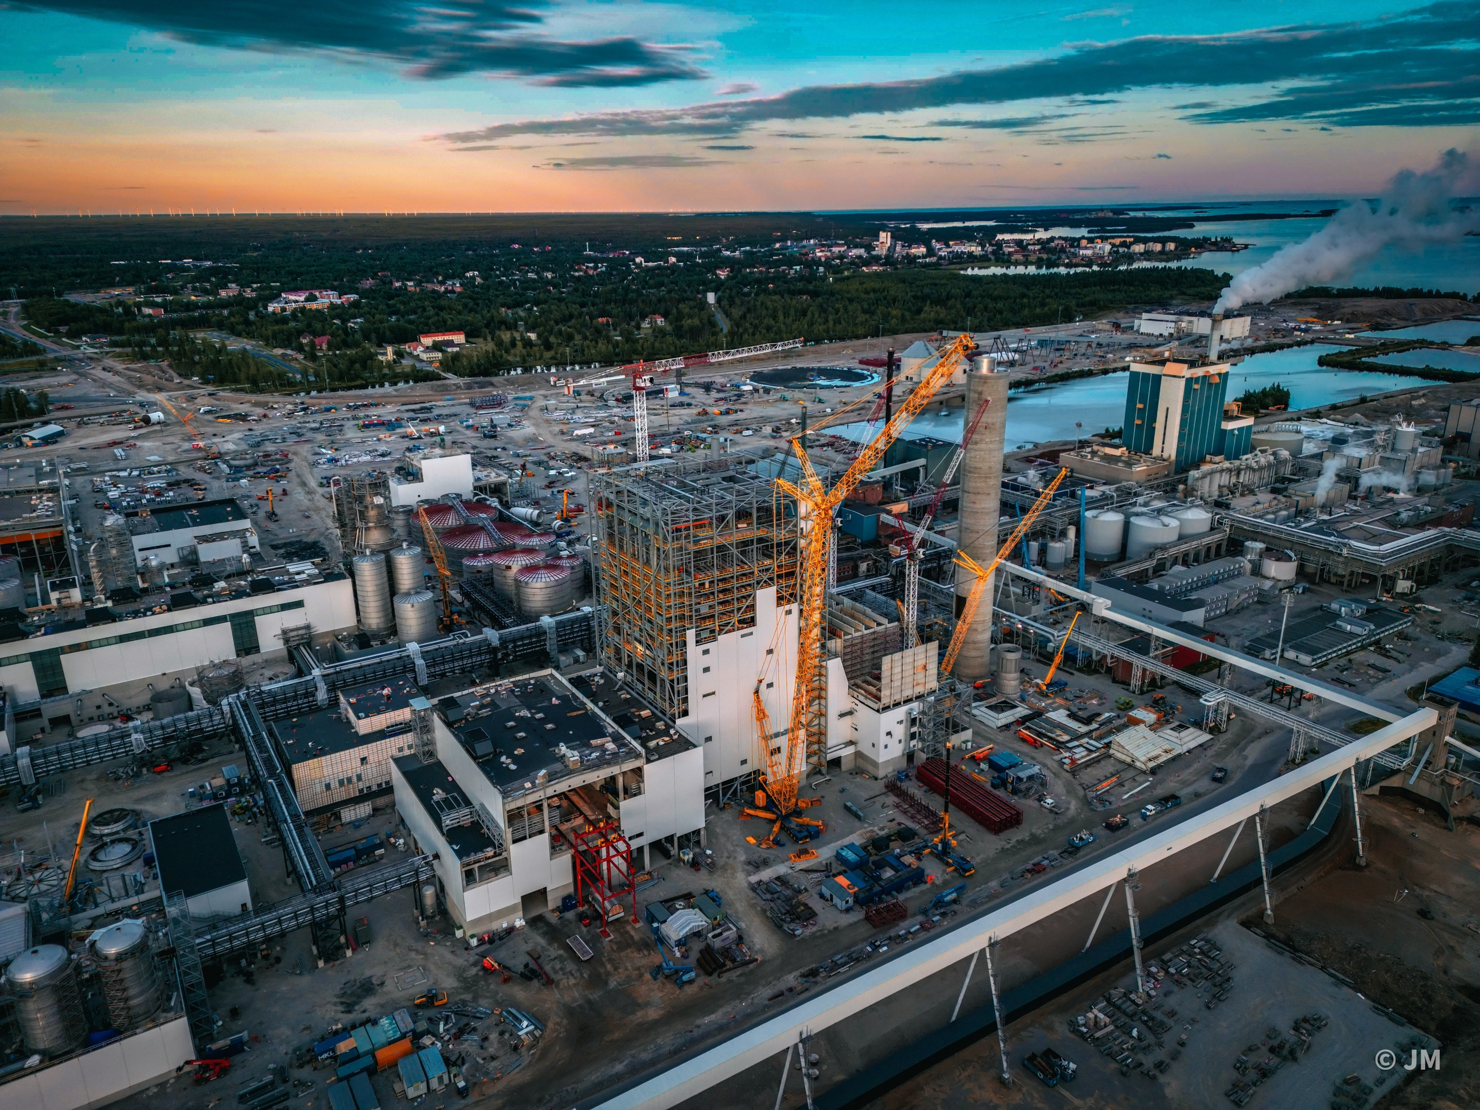
TECHNOLOGICAL EQUIPMENT INSTALLATION
Nov 2021 – Aug 2023
BIOPRODUCT MILL
RECOVERY BOILER 8000 TDS/D INSTALLATION
Hutní montáže, a.s. installed a high-capacity recovery boiler for Metsä Fibre’s fossil-free bioproduct mill in Kemi, Finland, as a subcontractor for Metsä Fibre OY/Valmet Technologies OY. The company handled the boiler’s pressure and non-pressure parts, HP piping, equipment, and ducts. The mill produces 1.5 million tons of pulp annually, aims for zero waste by 2030, and uses modern tech for bioenergy. The project built on previous success in Äänekoski..
METSÄ FIBRE OY/VALMET TECHNOLOGIES OY
KEMI, FINLAND
Notes:
Kemi
Hutní montáže, a.s. participated in the construction of a high-capacity recovery boiler for Metsä Fibre’s new bioproduct mill in Kemi, Finland. As a subcontractor for Metsä Fibre Oy/Valmet Technologies Oy, the company was responsible for recovery boiler’s pressure part and non-pressure parts, HP piping, equipment and ducts installation.
The new mill produces 1.5 million tons of pulp from softwood and hardwood annually. The operation is entirely fossil-fuel-free, to achieve zero waste by 2030. Modern technologies enable the efficient utilization of all by-products and the production of bioenergy. The new recovery boiler is designed with modern features for high efficiency and energy performance, contributing to the mill’s fossil-free operation. The project was contracted on previous successful cooperation in the Äänekoski project.

Slide 15
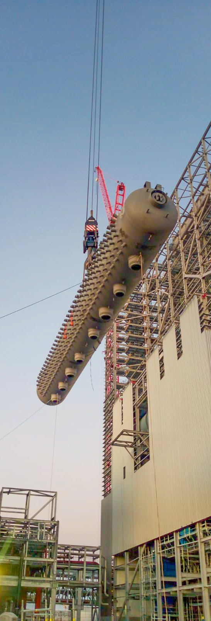
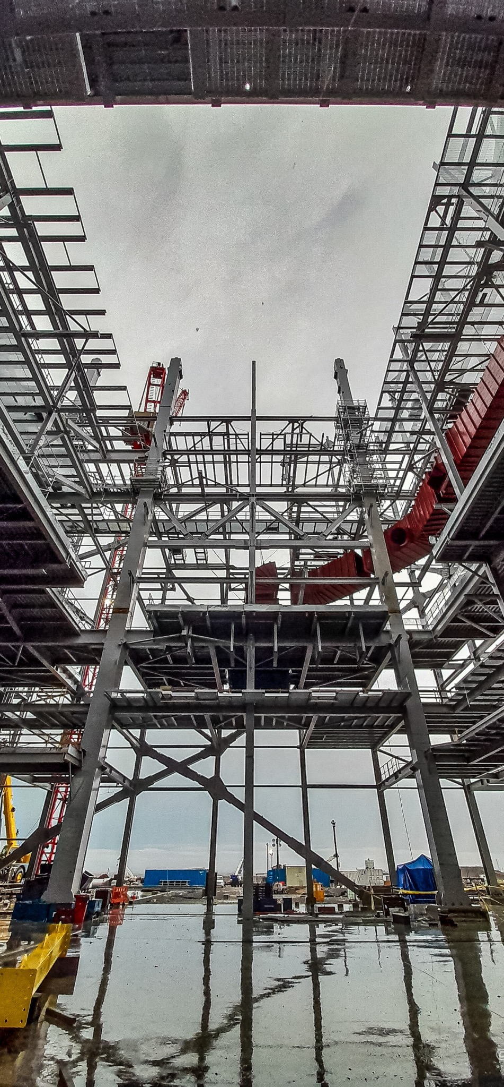
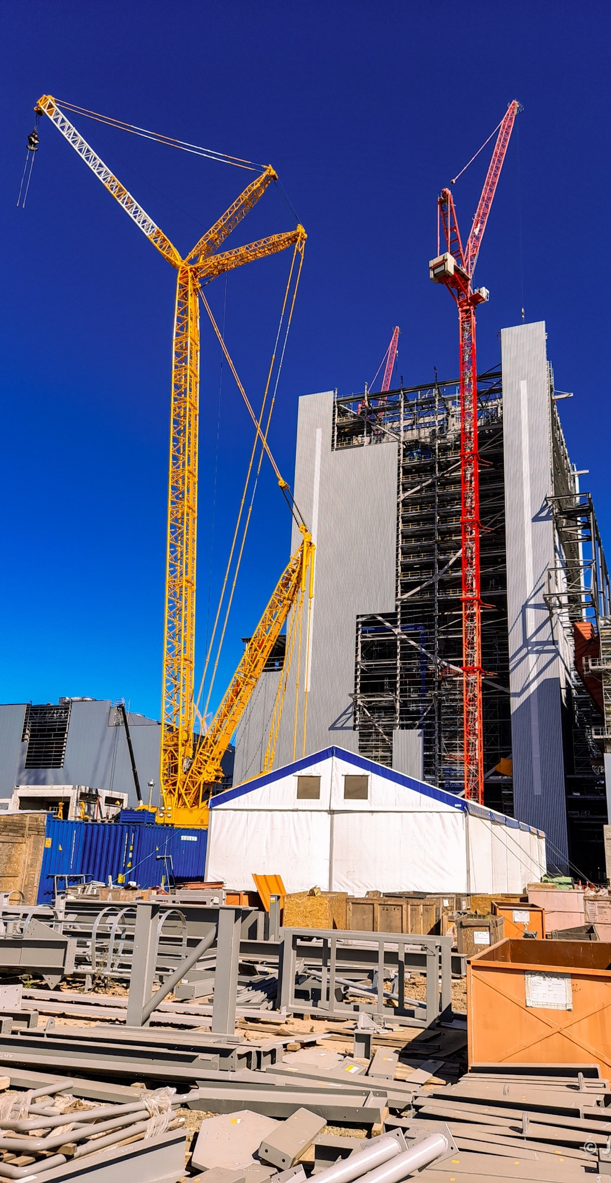
TECHNOLOGICAL EQUIPMENT INSTALLATION
Dec 2020 – Jul 2022
TAURUS PAPER MILL
Recovery boiler 9000 tds/d and Power boiler BFB 126 t/h installation
In the Taurus project in Uruguay, Hutní montáže, a.s. installed a recovery and power boiler for UPM and Andritz, handling steel structures, pressure/non-pressure parts, HP piping, equipment, and ducts. The UPM Paso de los Toros mill, launched in April 2023, produces 2.1 million tonnes of eucalyptus pulp annually, operates with high energy efficiency, and supplies about 1 TWh of surplus green electricity to Uruguay’s grid.
ANDRITZ PULP TECHNOLOGIES S.A./BLANVIRA S.A.
PASO DE LOS TOROS, URUGUAY
Notes:
TAURUS
In the Taurus project in Paso de los Toros, Uruguay, Hutní montáže, a.s. installed a high-capacity recovery boiler and power boiler for UPM and Andritz. The company was responsible for the installation of steel structure, pressure and non-pressure parts, HP piping, equipment and ducts for both boilers.
The UPM Paso de los Toros pulp mill, also known as the Taurus project, is a significant industrial development in Uruguay. This state-of-the-art facility began operations in April 2023 and has an annual production capacity of 2.1 million tonnes of eucalyptus pulp. The mill operates with high energy efficiency and minimal environmental impact, contributing approximately 1 terawatt-hour of surplus green electricity per year to Uruguay's power supply.

Slide 16
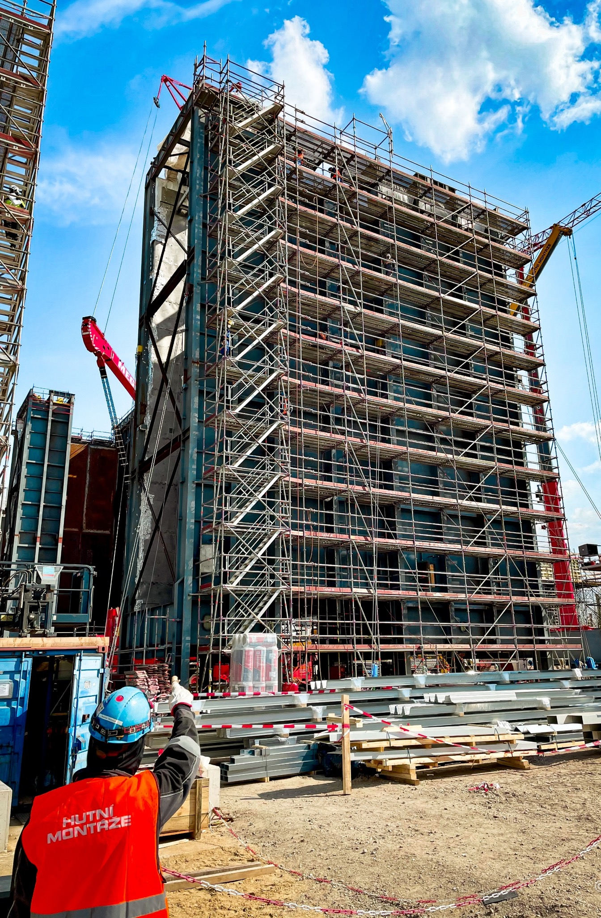
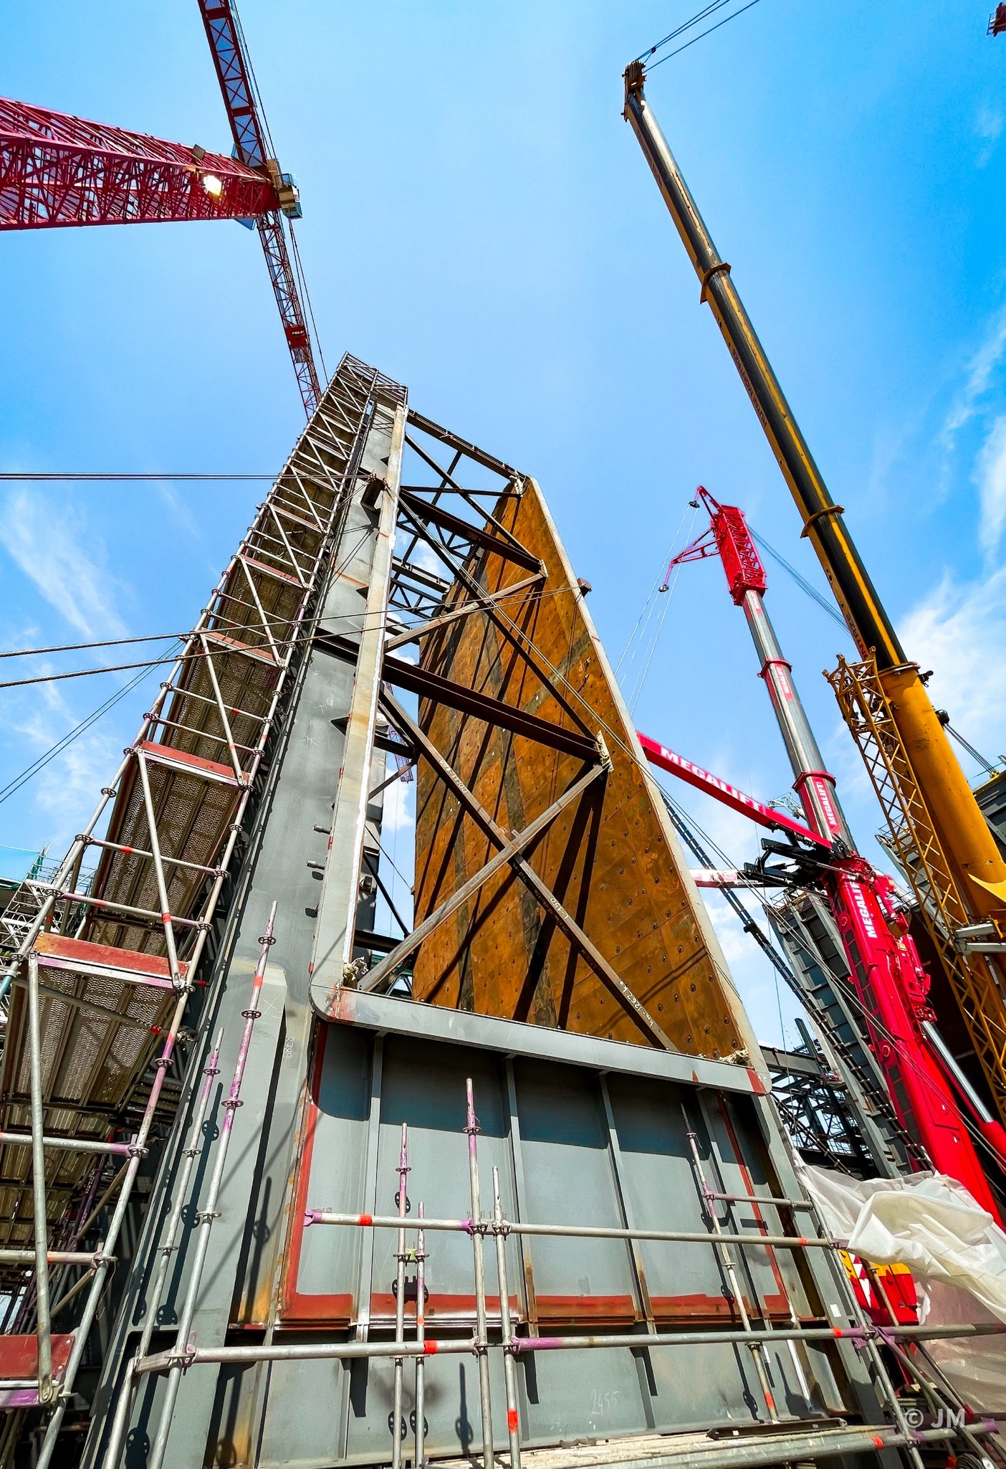
TECHNOLOGICAL EQUIPMENT INSTALLATION
Nov 2020 – Aug 2021
HKW WOLFSBURG WEST
Installation of 2 HRSG power boilers
In the Wolfsburg project, Hutní montáže, a.s. worked with Mitsubishi Power Europe on the installation of HRSG boilers. The project focused on increasing energy efficiency and reducing emissions at the facility, contributing to more sustainable and reliable industrial operations.
MITSUBISHI POWER EUROPE GmbH
WOLFSBURG, GERMANY
Notes:
Wolfsburg
In the Wolfsburg project, Hutní montáže, a.s. worked with Mitsubishi Power Europe on the installation of two HRSG boilers. Our company was responsible for the installation of the HRSG boiler’s pressure and non-pressure parts, HP piping, ducts and stack.
The new gas-and-steam cogeneration plant at the "Heizkraftwerk Wolfsburg-West" facility involved replacing two existing coal-fired units with a gas-fired double block. The new plant features two H-100 class gas turbines, two waste heat recovery boilers (HRSGs), and two steam turbines, collectively generating approximately 288 megawatts (MW) of electricity and about 265 MW of heat

Slide 17
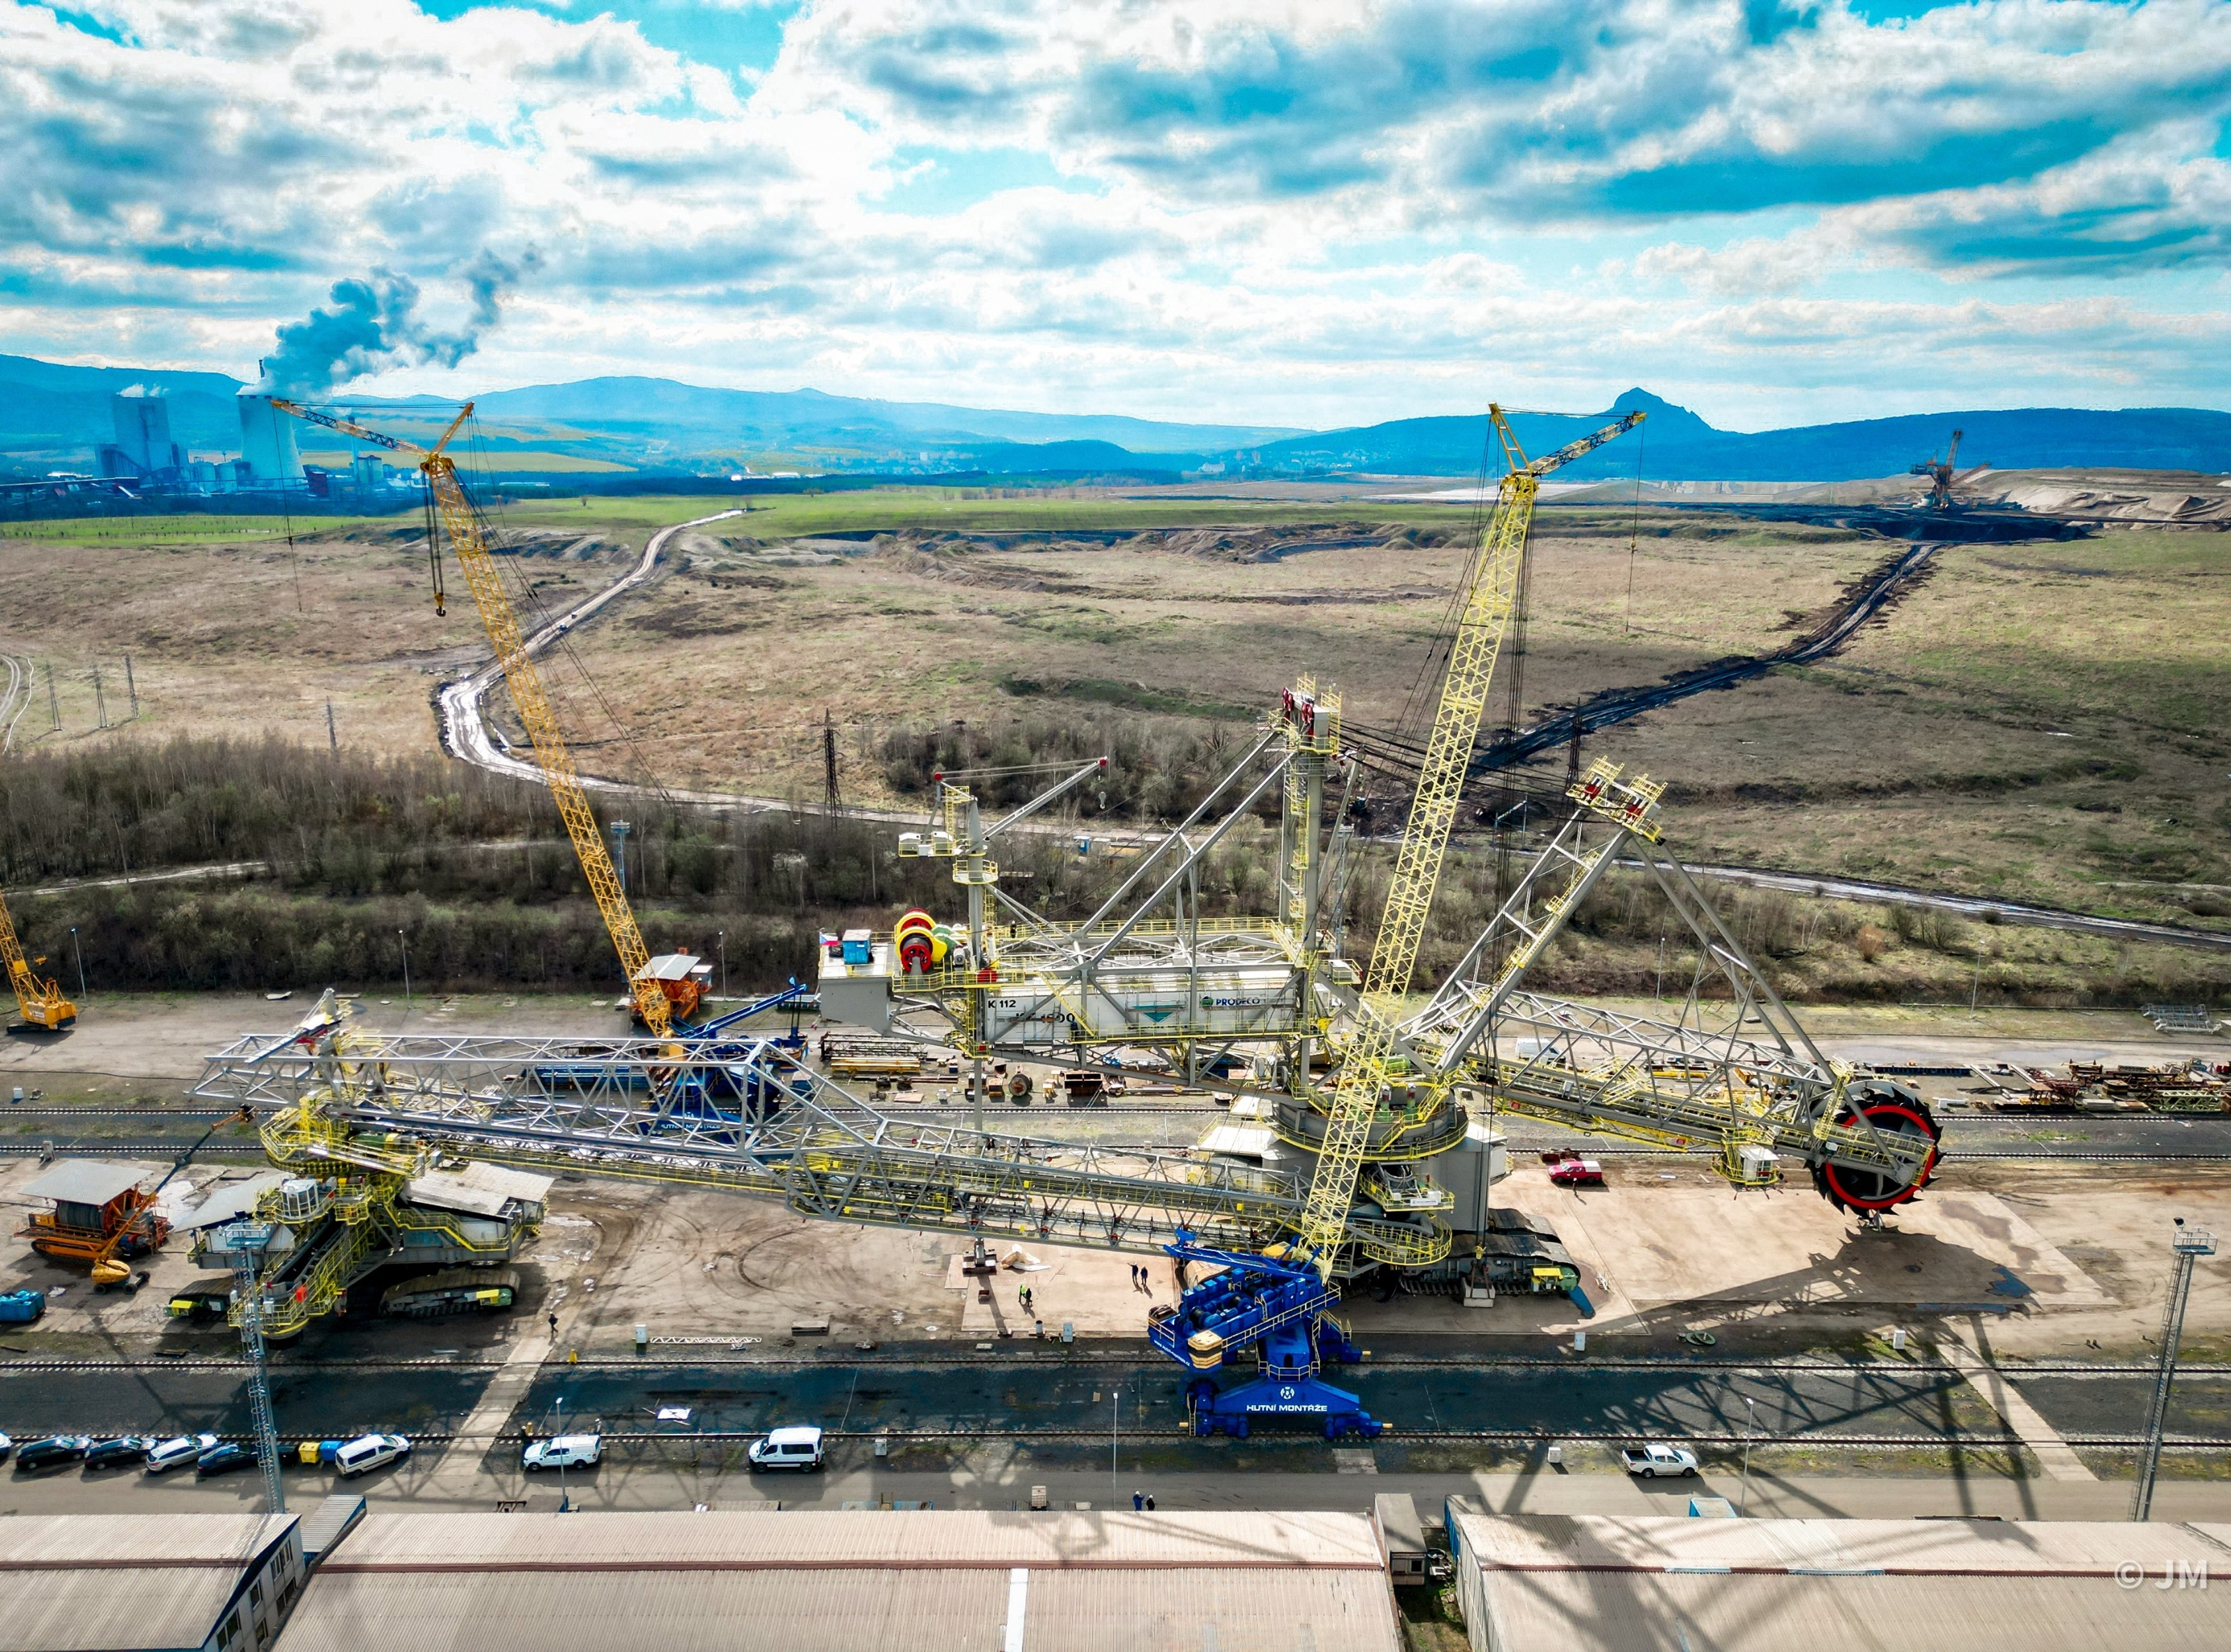
TECHNOLOGICAL EQUIPMENT INSTALLATION
Jan 2020 – Dec 2022
PROJECT KK1600
Delivery and installation of giant bucket wheel excavator
The KK1600 project involved assembling a large bucket wheel excavator for challenging overburden mining. Hutní montáže, a.s. was responsible for the precise installation of its steel and mechanical components, showcasing their expertise in complex industrial assemblies.
PRODECO A.S.
BÍLINA, CZECH REPUBLIC
Notes:
KK 1600
The KK1600 project Hutní montáže, a.s. was responsible for the supply and precise installation of its steel and mechanical components, showcasing their expertise in complex industrial assemblies.
The KK 1600 is a bucket wheel excavator designed for large-scale open-pit mining operations, capable of efficiently handling significant volumes of overburden or minerals. While specific details about the KK 1600 model are limited, similar excavators provide insight into its potential specifications and capabilities.

Slide 18
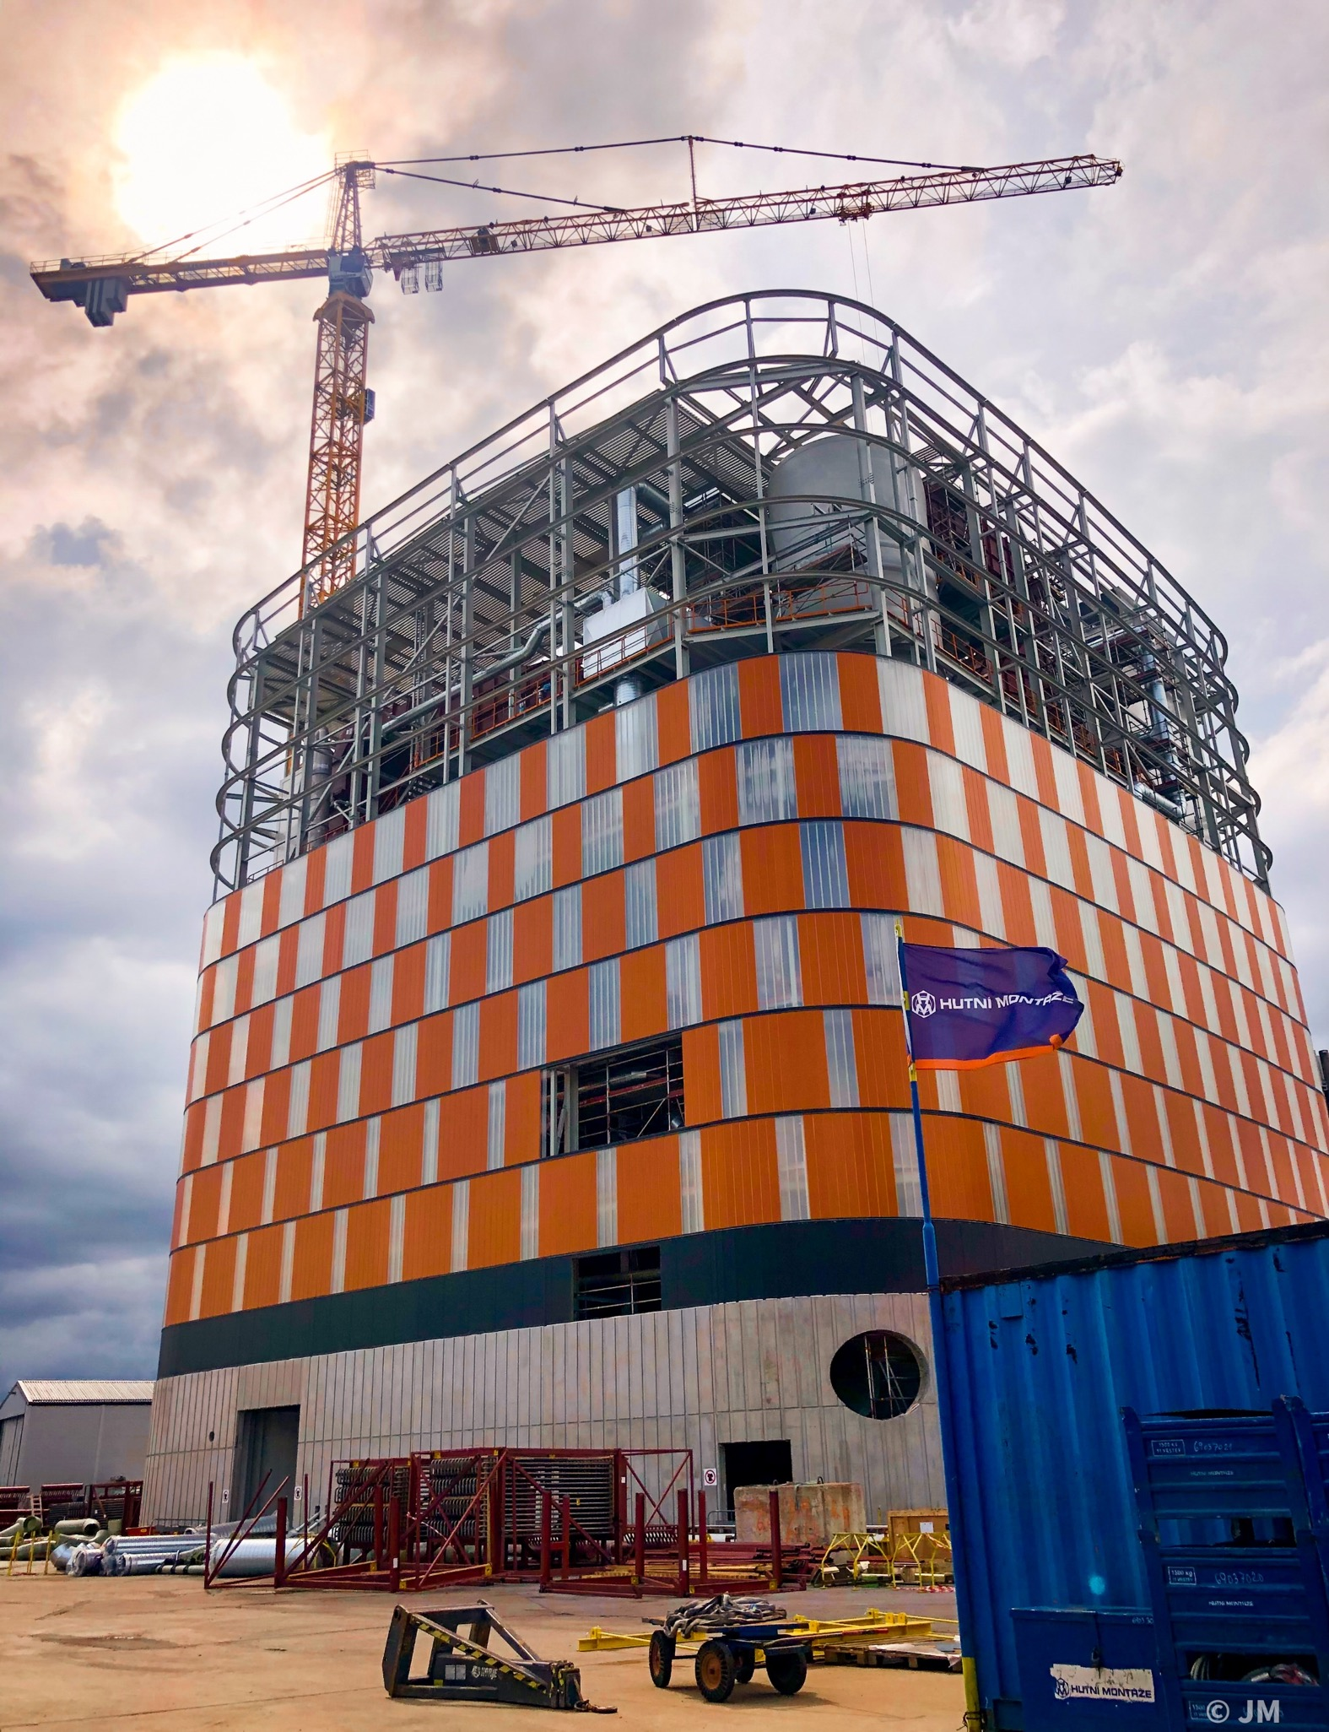
Mar 2020 – Mar 2021
CARPE FUTURUM
Installation of power boiler
Hutní montáže, a.s. participated in the Carpe Futurum project in Uppsala, Sweden, where they were responsible for assembling the pressure and non-pressure parts, HP piping, equipment and ducts of the power boiler system. This project involved the installation of complex equipment, highlighting the company's expertise in executing large-scale industrial assemblies. The project is part of Vattenfall’s “Carpe Futurum” initiative, aimed at phasing out fossil fuels from district heating in Uppsala. It can be fired using a mix of renewable fuels including wood chips, recycled biomass, and bark. The new boiler has a thermal power capacity of 110 MWth.
ANDRITZ OY
UPPSALA, SWEDEN
Notes:
Uppsala
​Hutní montáže, a.s. participated in the Carpe Futurum project in Uppsala, Sweden, where they were responsible for assembling the pressure and non-pressure parts, HP piping, equipment and ducts of the power boiler system. This project involved the installation of complex equipment, highlighting the company's expertise in executing large-scale industrial assemblies.
The project is part of Vattenfall’s “Carpe Futurum” initiative, aimed at phasing out fossil fuels from district heating in Uppsala. It can be fired using a mix of renewable fuels including wood chips, recycled biomass, and bark. The new boiler has a thermal power capacity of 110 MWth.

Slide 19
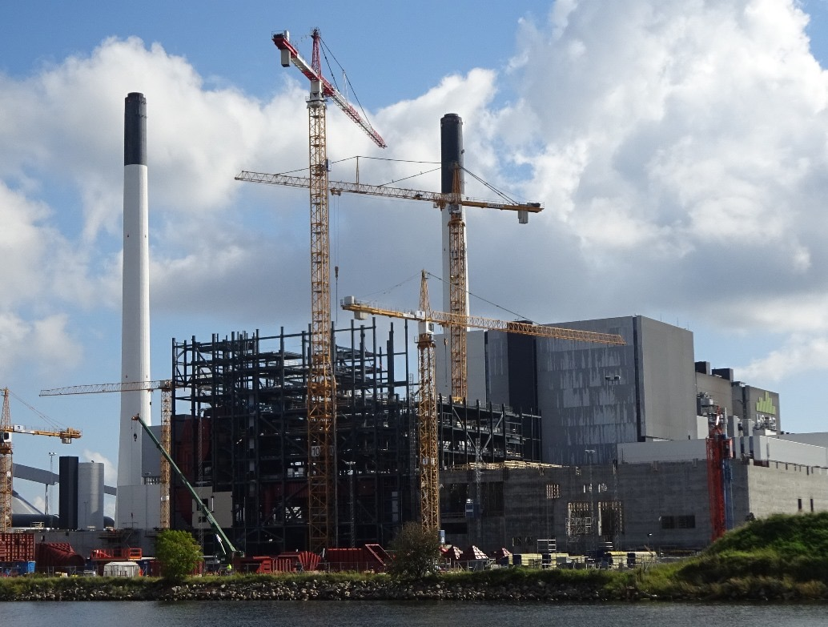
TECHNOLOGICAL EQUIPMENT INSTALLATION
2017 – 2019
HOFOR
Installation of power boiler 500 MW
The HOFOR BIO4 project at Amager Power Station in Copenhagen (2017–2019) involved the installation of a 500 MW fluidized bed boiler, including pressure and non-pressure parts, piping systems, equipment, and ducts. It replaced an old coal unit to support the city’s transition to biomass and CO₂ neutrality.
VALMET TECHNOLOGIES OY
HOFOR, DENMARK
Notes:
Hutní montáže, a.s. was involved in the HOFOR BIO4 project at the Amager Power Station in Copenhagen, Denmark, from April 2017 to April 2019. Their work included the mechanical installation of a 500 MW fluidized bed boiler, focusing on assembling pressure and non-pressure parts, high-pressure and low-pressure piping systems, equipment and ducts.
The HOFOR BIO4 is part of Copenhagen’s effort to achieve CO₂ neutrality by transitioning from coal to sustainable biomass. The project replaces an old coal-fired unit, helping to significantly reduce CO₂ emissions in the city.

Slide 20
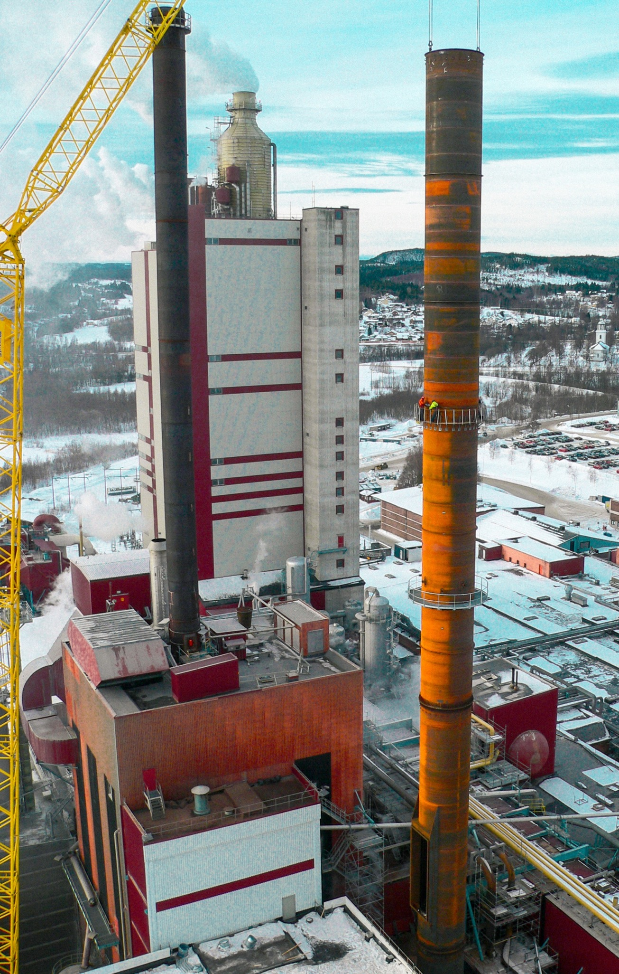
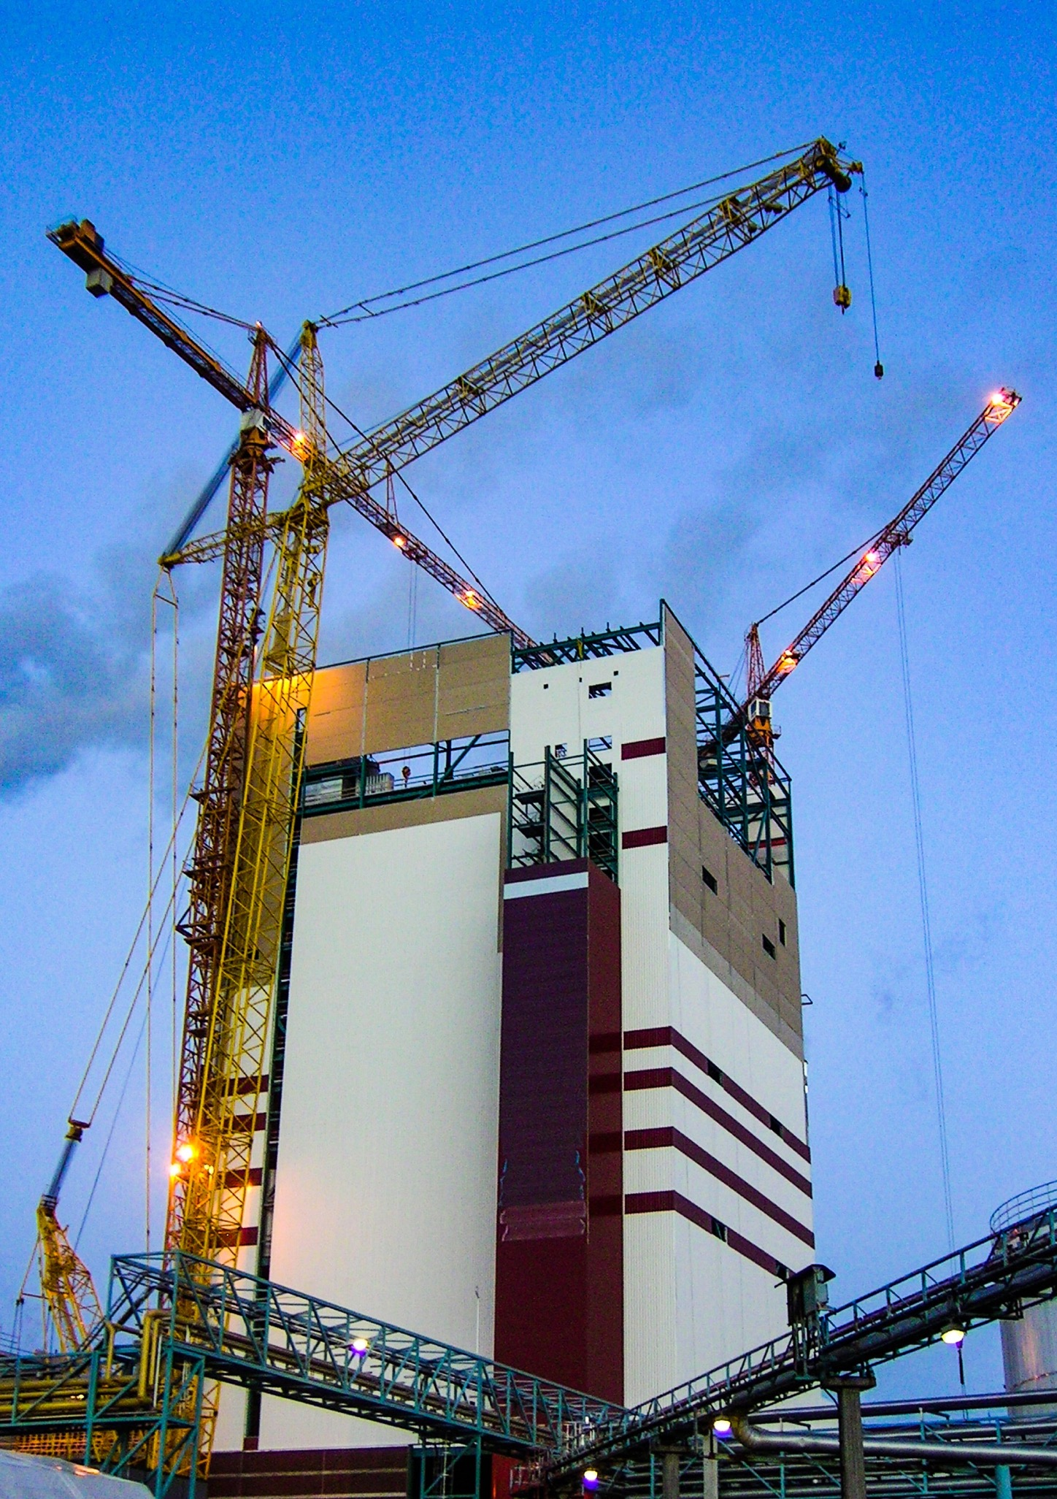
TECHNOLOGICAL EQUIPMENT INSTALLATION
Aug 2017 – Jun 2018
PROJECT HELIOS
Expansion of a pulp mill to double production capacity
An expansion project that transformed the Östrand mill into one of the largest producers of NBSK pulp in the world. During the shutdown phase, Hutní montáže performed dismantling and modification of pipelines and supported process optimization through precise mechanical adjustments.
ANDRITZ OY
ÖSTRAND, SWEDEN

Slide 21
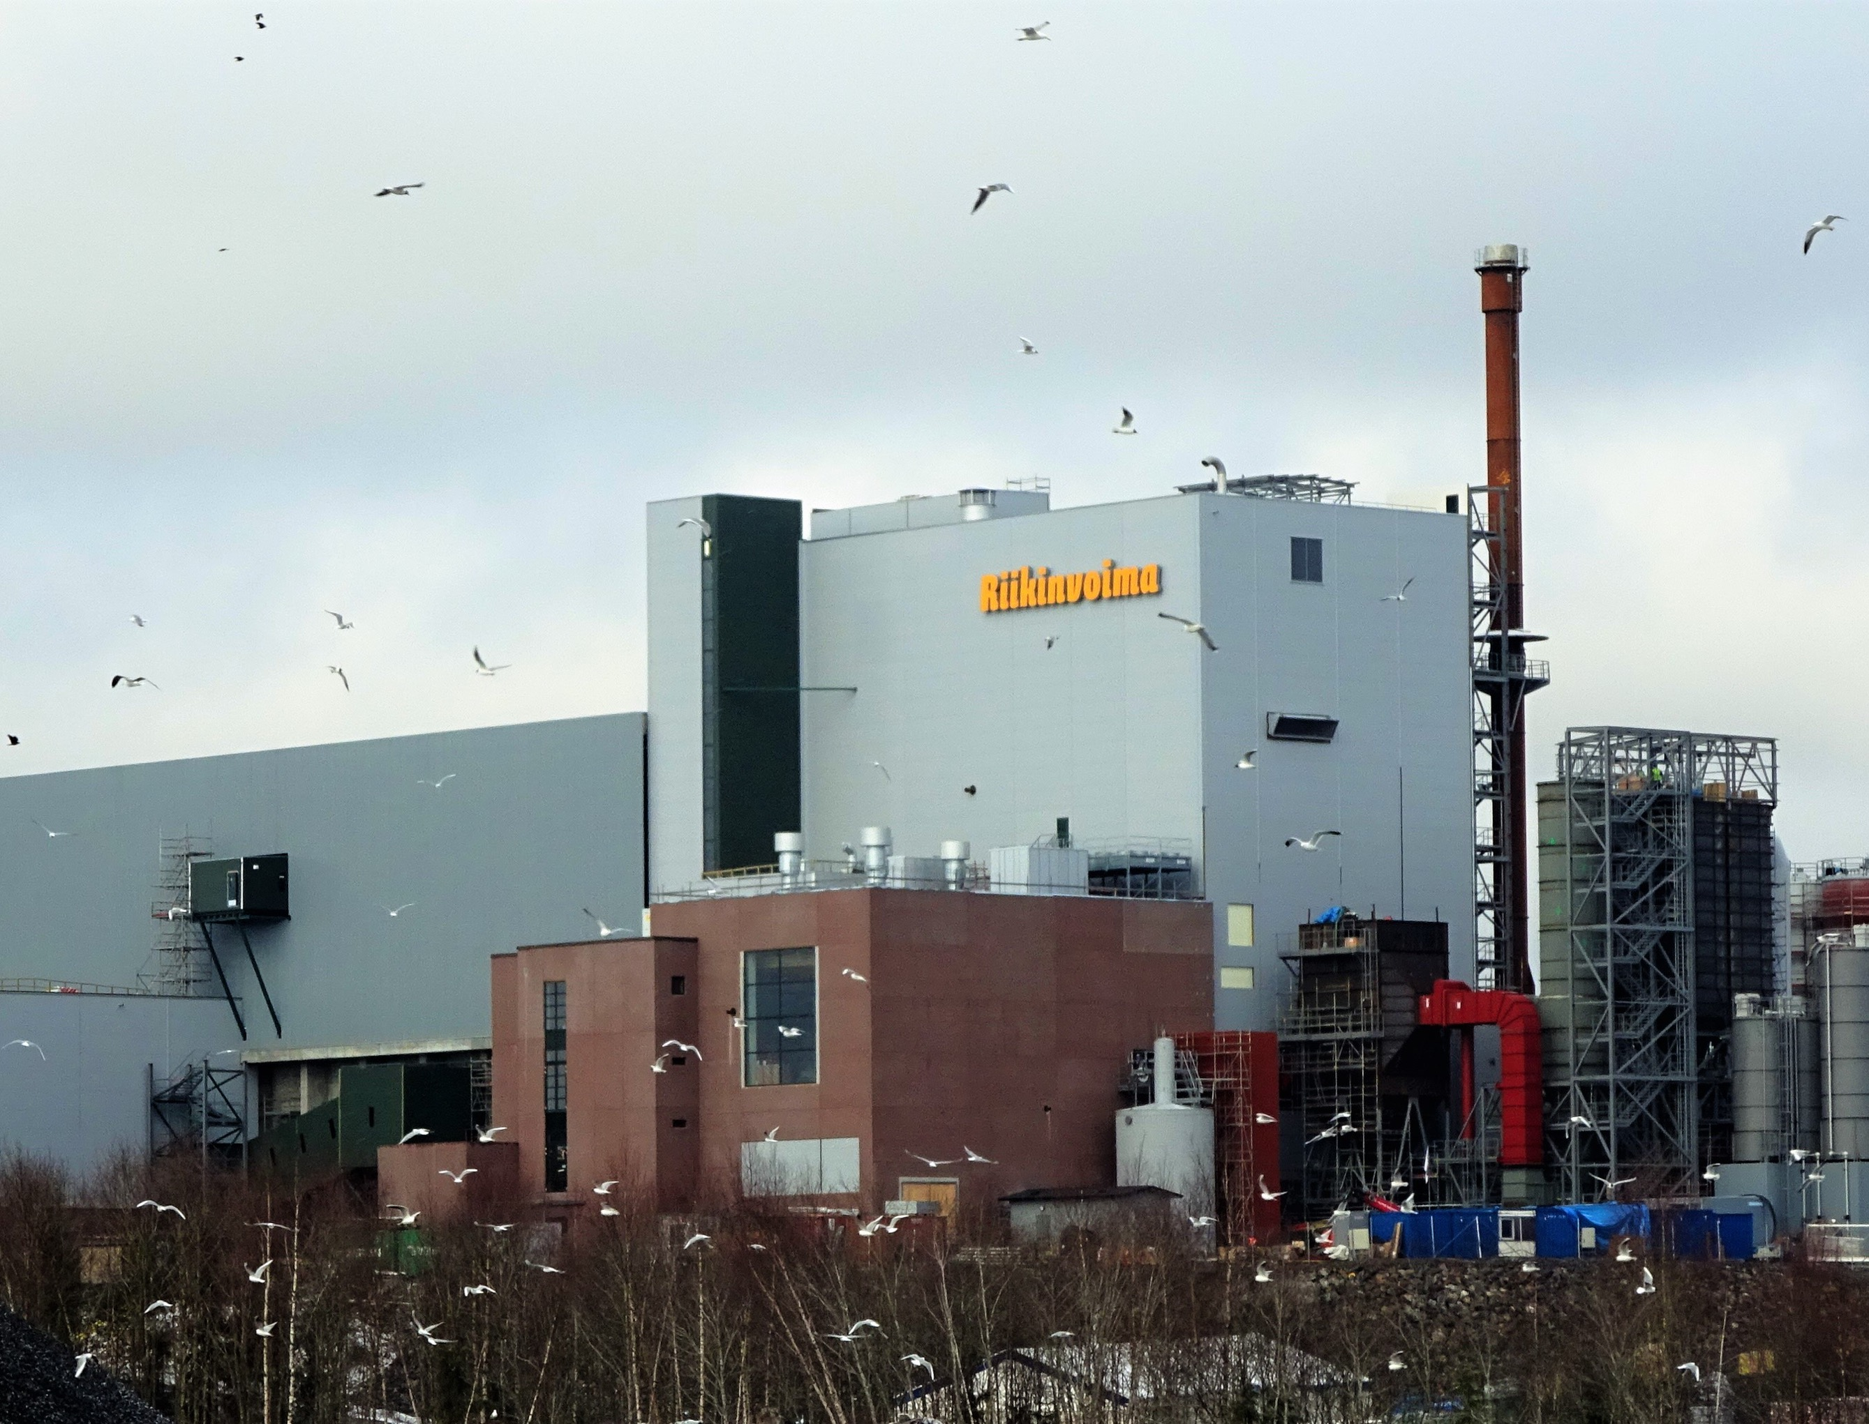
TECHNOLOGICAL EQUIPMENT INSTALLATION
2015 – 2016
RIIKINVOIMA PROJECT
Installation of boiler-related technical equipment.
A combined heat and power (CHP) plant in Varkaus converting municipal waste into electricity and district heating. Hutní montáže carried out the installation of key boiler components and technical systems, contributing to a cleaner and more efficient energy solution.
ANDRITZ OY
RIIKINVOIMA, FINLAND

Slide 22
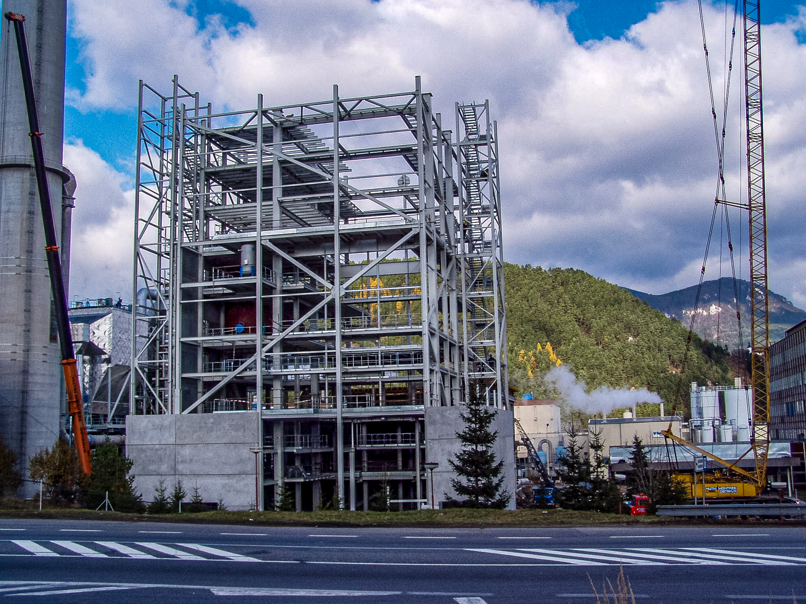
TECHNOLOGICAL EQUIPMENT INSTALLATION
2013 - 2014
PROJECT RUŽOMBEROK
Installation of a recovery boiler at the Mondi SCP pulp mill.
Located at the Mondi SCP pulp mill, this project involved the installation of a recovery boiler with a capacity of 900 tds/day. Hutní montáže performed the assembly of boiler pressure parts, piping, and auxiliary equipment as part of a larger modernization effort.
ANDRITZ OY
RUŽOMBEROK, SLOVAKIA

Slide 23
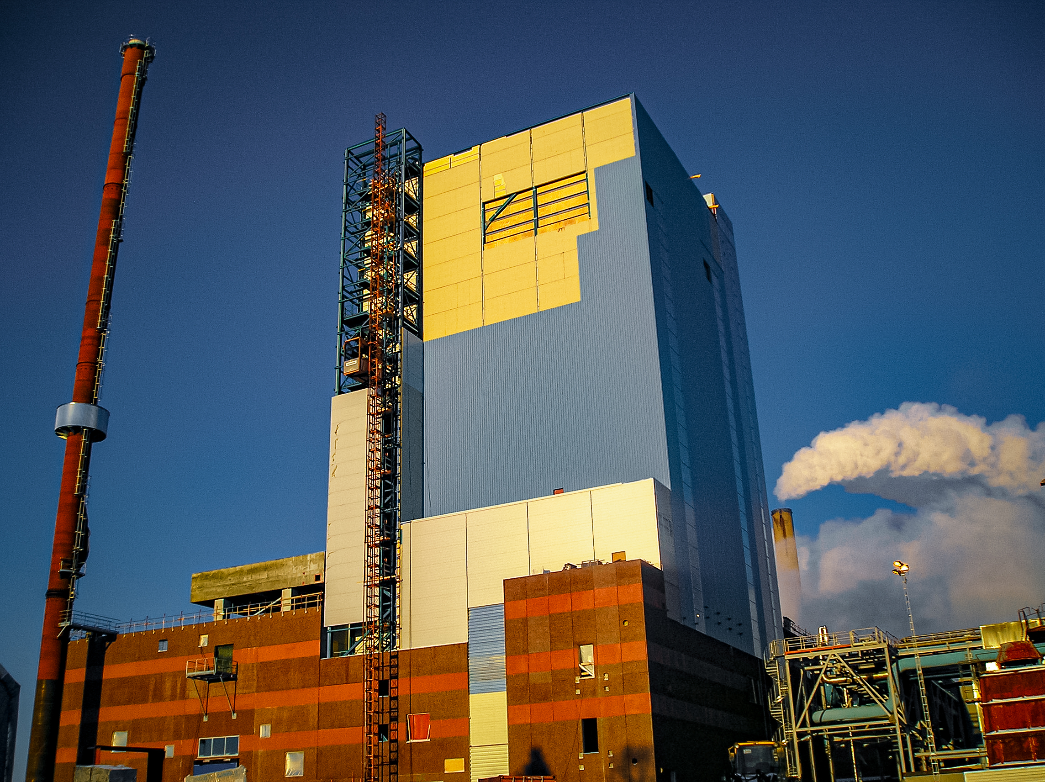
TECHNOLOGICAL EQUIPMENT INSTALLATION
Sep 2006 – Aug 2007
RECOVERY BOILER OBBOLA
Upgrade at the SCA Obbola kraftliner plant to support higher production.
Part of an upgrade at SCA’s Obbola kraftliner plant, enabling increased production capacity. Hutní montáže assembled recovery boiler components in partnership with Andritz, delivering high-precision work in a tight schedule to maintain plant operations.
ANDRITZ OY
OBBOLA, SWEDEN

Slide 24
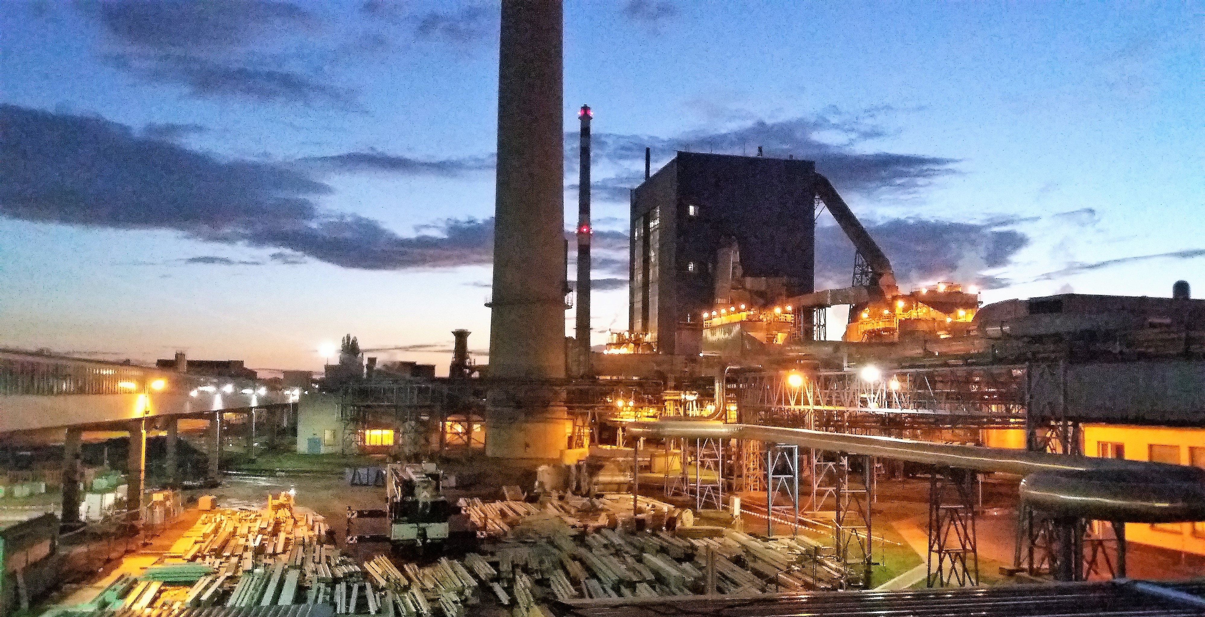
TECHNOLOGICAL EQUIPMENT INSTALLATION
2017 - 2018
MONDI ŠTĚTÍ RB12
Installation of a recovery boiler 2800 tds/d
Located at the Mondi Štětí pulp mill, this project involved the installation of a recovery boiler with a capacity of 2800 tds/d. Hutní montáže performed the assembly of boiler pressure parts, piping, and auxiliary equipment including ESP as part of a larger modernization effort.
VALMET TECHNOLOGIES OY
ŠTĚTÍ, CZECH REPUBLIC

Slide 25
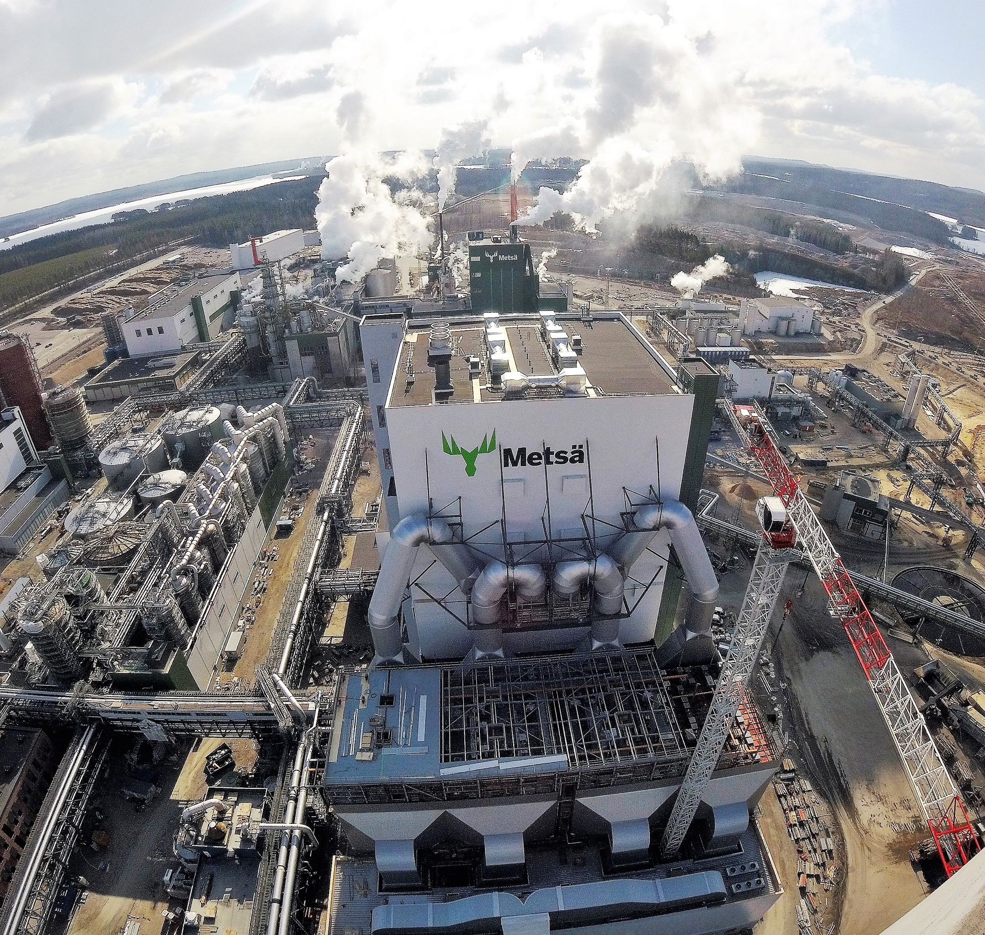
TECHNOLOGICAL EQUIPMENT INSTALLATION
Feb 2016 – Apr 2017
RECOVERY BOILER ÄÄNEKOSKI
Recovery boiler 7200tds/d
Hutní montáže, a.s. installed a high-capacity recovery boiler for Metsä Fibre’s fossil-free bioproduct mill in Äänekoski, Finland, as a subcontractor for Metsä Fibre OY/Valmet Technologies OY. The company handled the boiler’s pressure and non-pressure parts, HP piping, equipment, and ducts.
METSÄ FIBRE OY/VALMET TECHNOLOGIES OY
ÄÄNEKOSKI, FINLAND

Slide 26
ONGOING AND RECENT PROJECTS
TECHNOLOGICAL EQUIPMENT INSTALLATION
Year | Title | Scope of supply | Customer | Location
02/2024 - 03/2025 | EcoKraft Mondi Štětí | Supply and installation of piping systems into pipe bridges | Mondi Štětí, a.s. | Štětí, Czech Republic
04/2024 - 06/2024 | Unipetrol Litvínov | Optimization of vacuum distillation unit | ROEZ, s.r.o. | Litvínov, Czech Republic
01/2024 - 12/2024 | DSS Viana RBO | Recovery boiler 950 tds/d installation | VALMET LDA | Viana do Castelo, Portugal
05/2023 - 09/2023 | Luxenergie Kirchberg II | Mechanical erection of energy plant, piping installation | Vyncke N.V. | Luxembourg, Luxembourg
11/2021 - 08/2023 | KEMI Bioproduct Mill | Recovery boiler 8000 tds/d installation | Metsä Fibre OY | Kemi, Finland
 |  |  | Valmet Technologies OY
12/2020 - 07/2022 | TAURUS PULP MILL PROJECT | Recovery boiler 9000 tds/d and Power boiler BFB 126 t/h installation | ANDRITZ PULP TECHNOLOGIES S.A. | Paso de los Toros, Uruguay
 |  |  | BLANVIRA S.A. (UPM)
01/2020 - 12/2022 | Project KK1600 | Delivery and installation of giant bucket wheel excavator | Severočeské doly, a.s. | Czech Republic
11/2020 - 08/2021 | HKW WOLGSBURG WEST | Installation of 2 HRSG power boilers | MITSUBISHI POWER EUROPE | Wolfsburg, Germany
 |  |  | Volkswagen AG
03/2020 - 03/2021 | CARPE FUTURUM PROJECT | Installation of biomass boiler BFB 100 MW | ANDRITZ OY | Uppsala, Sweden
 |  |  | Vattenfall AB
09/2019 - 06/2020 | Project RECLAIMER 1 | Installation of steel structure and technological equipment of reclaimer | Kadamo, s.r.o. | Třinec, Czech Republic
 |  |  | Třinecké železárny, a.s.
04/2020 - 12/2020 | Project RECLAIMER 2 | Installation of steel structure and technological equipment of reclaimer | WALBO ENGINEERING, s.r.o. | Třinec, Czech Republic

Slide 27
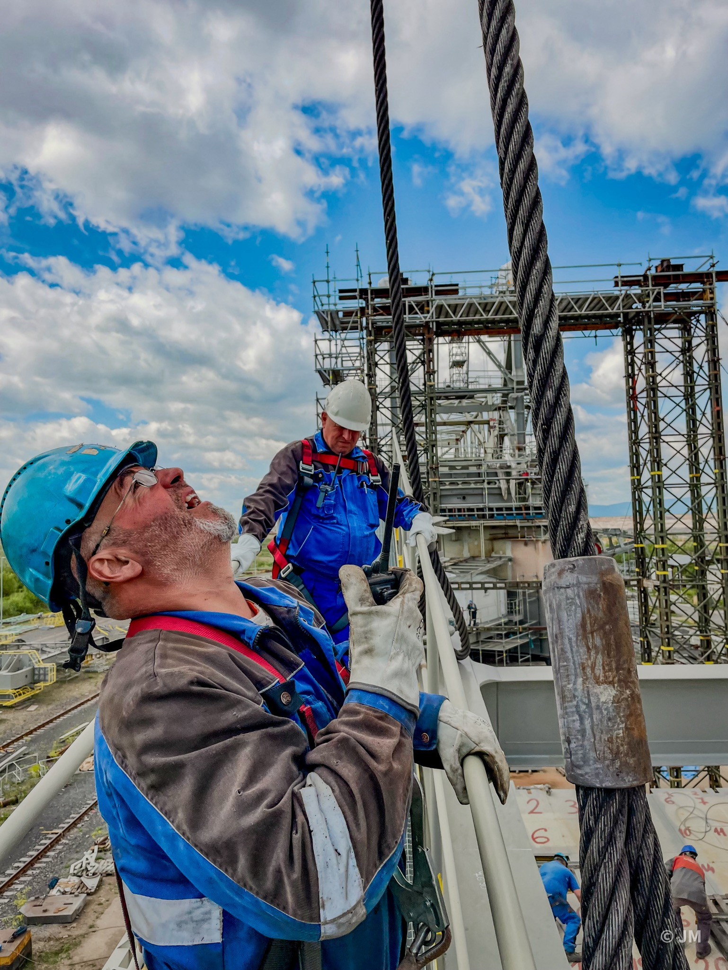
DIVISION OF
STEEL STRUCTURE AND BRIDGES
PROJECT REFERENCES
Steel Structure
Storage & Production Facilities
Public & Sports Buildings
Bridge Structures

Slide 28
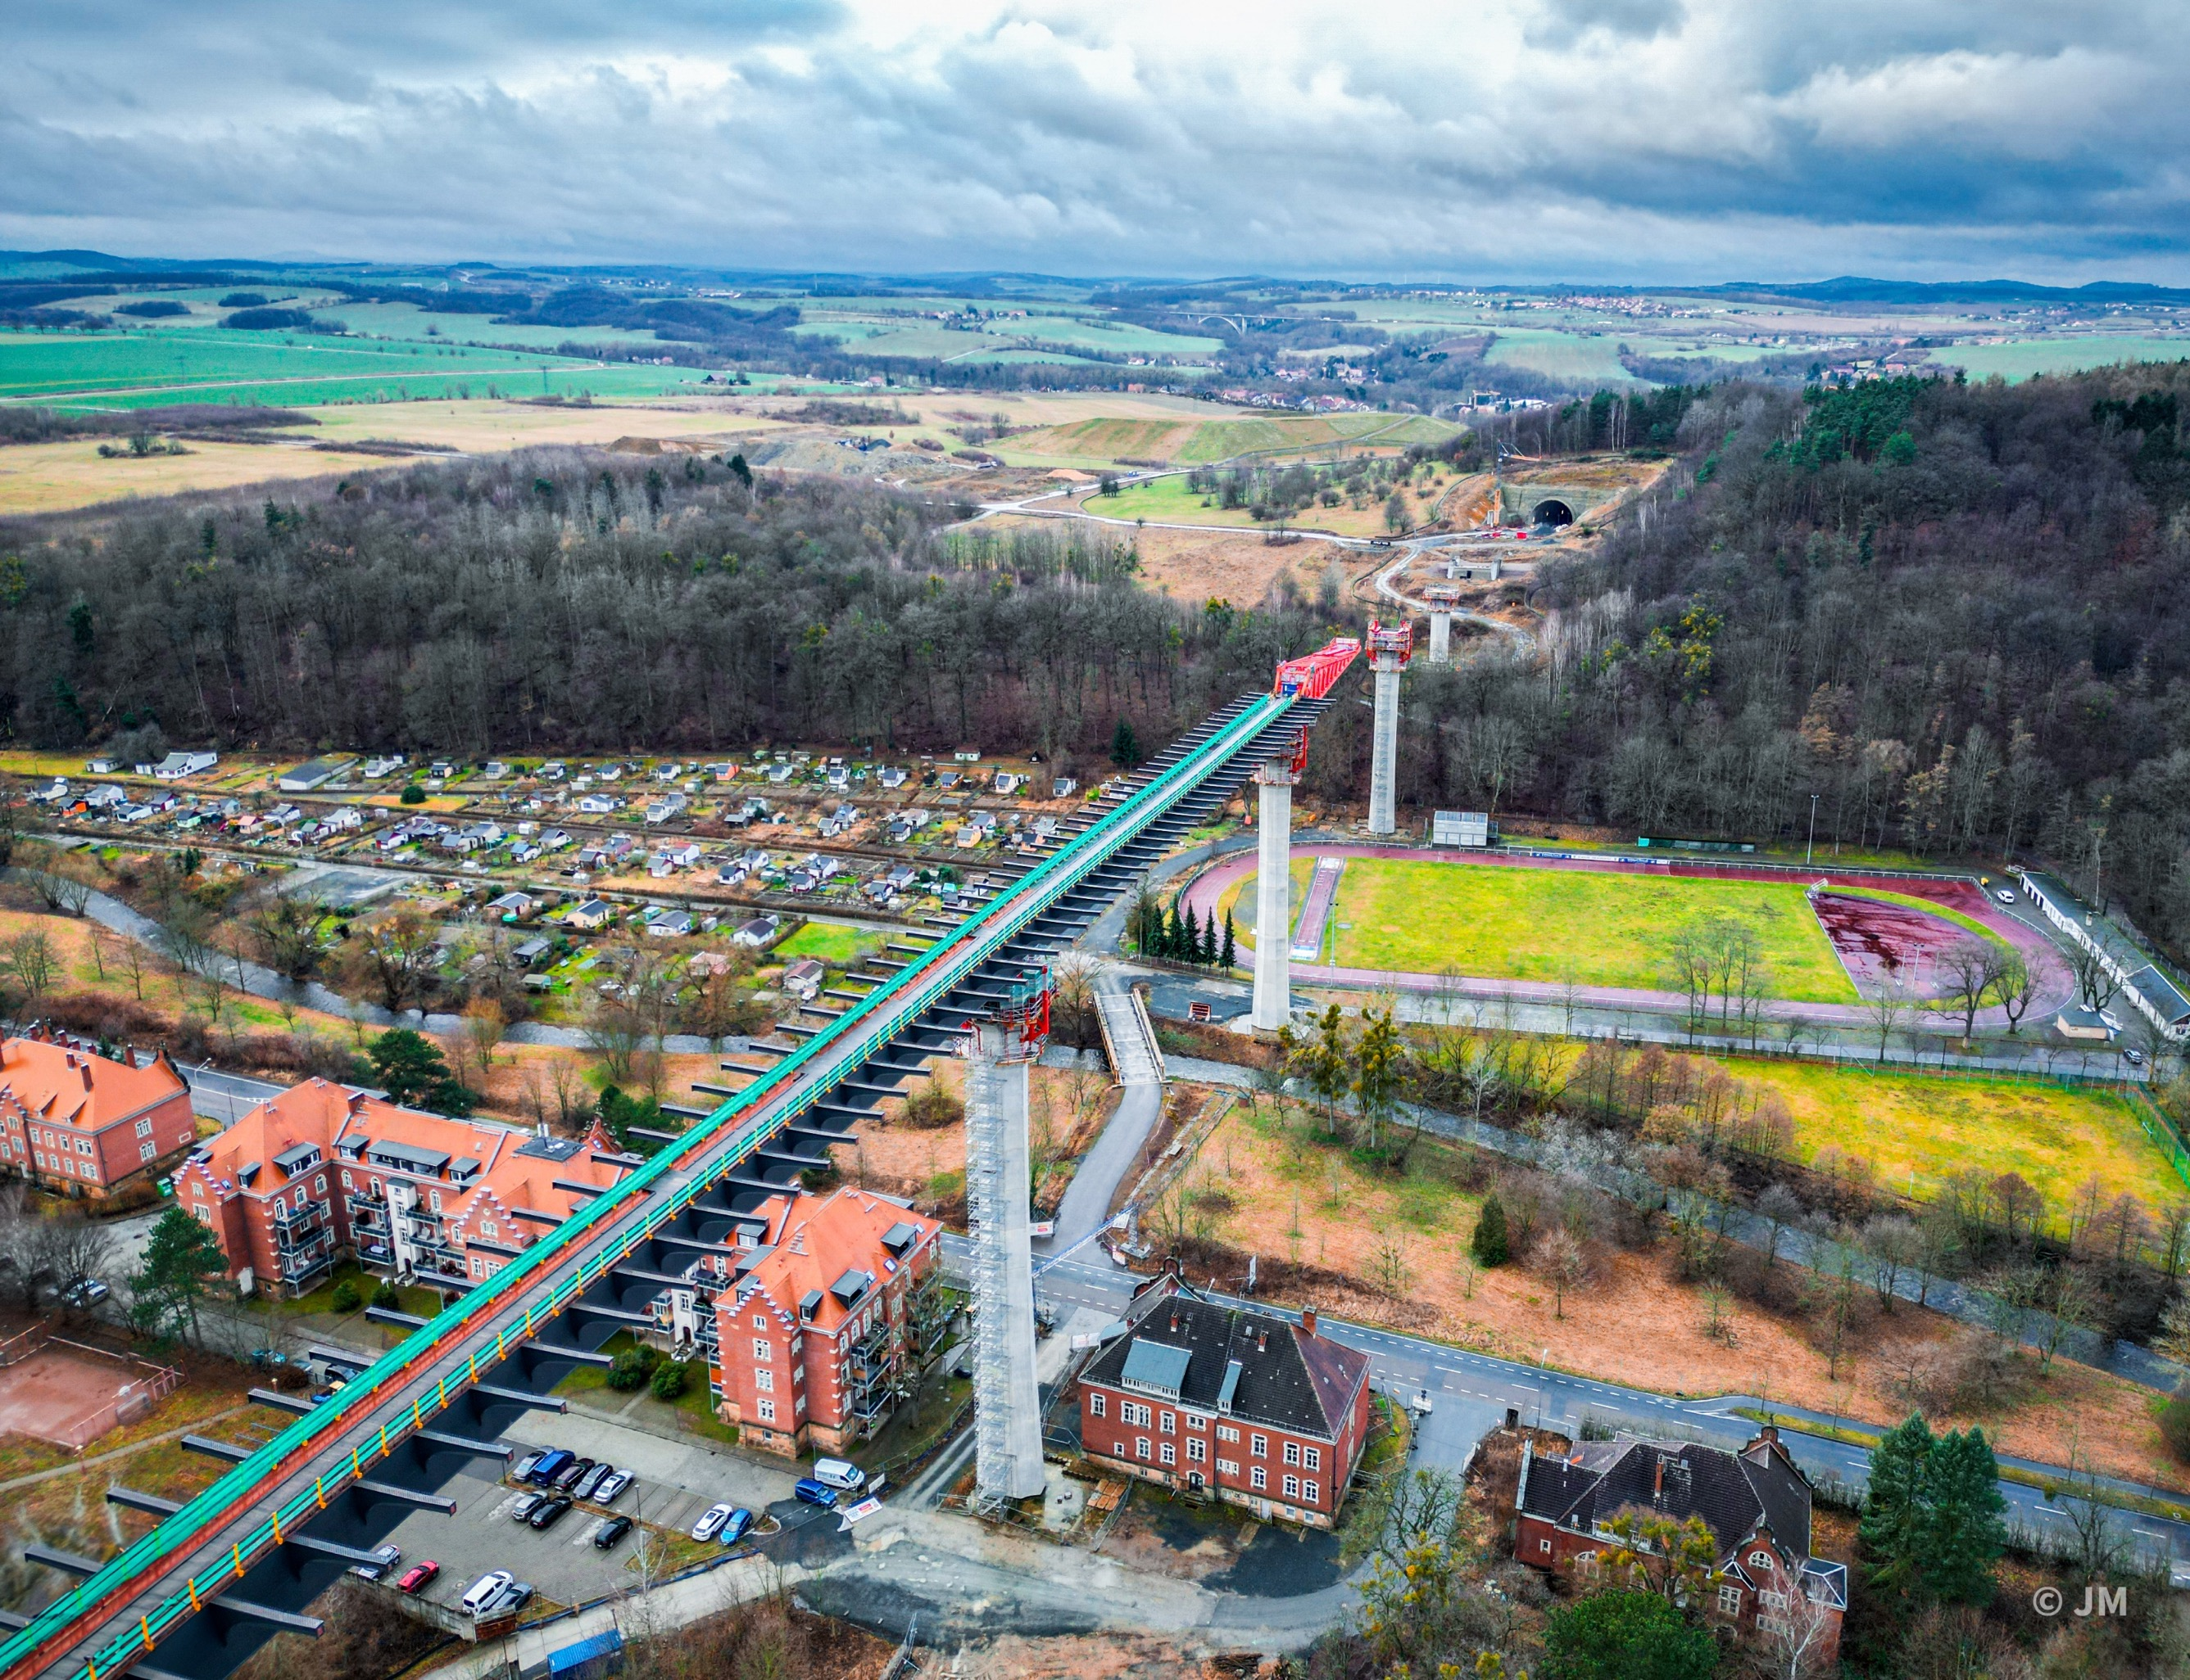
Steel structure and bridges
Aug 2020 – Dec 2024
BRIDGE PIRNA
Construction of structural steel of bridge
In the Pirna bridge project, Hutní montáže, a.s. was responsible for assembling major steel structures. The work required high precision and coordination, contributing to the successful construction of a bridge that strengthens the regional transport network.
PIRNA, GERMANY

Slide 29
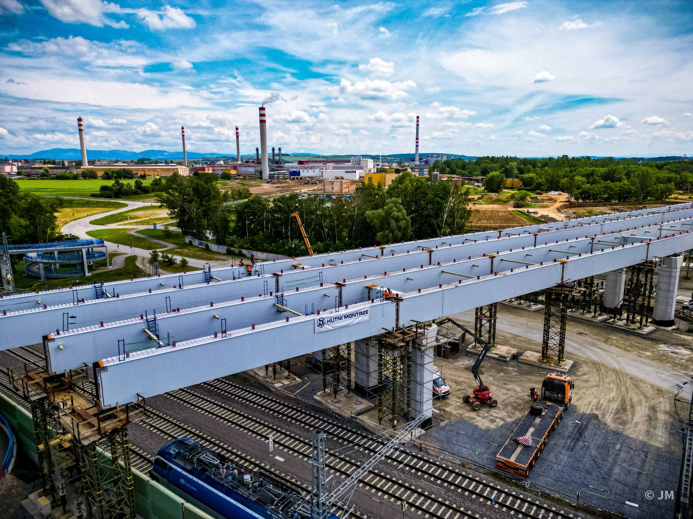
Steel structure and bridges
Nov 2023 – Oct 2024
BRIDGE PŘEROV
Construction of structural steel of bridge
Hutní montáže, a.s. carried out the steel structure assembly for a new bridge in Přerov on the main higway D1. The project emphasized precision and safety, contributing to smoother traffic and the overall improvement of the city's transport infrastructure.
PŘEROV, CZECH REPUBLIC

Slide 30
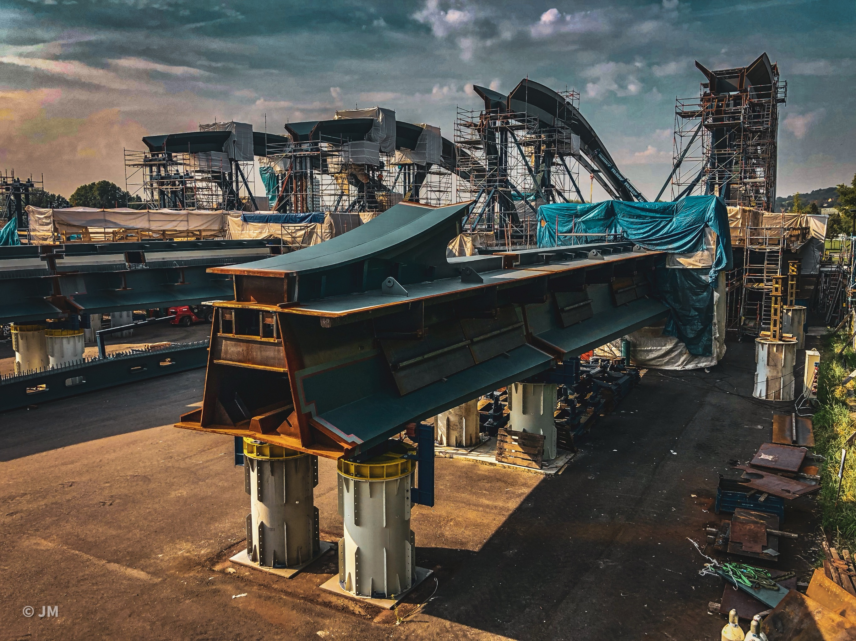
Steel structure and bridges
Sep 2019 – Nov 2020
BRIDGE LINZ
Construction of structural steel of bridge
Hutní montáže, a.s. played a significant role in the construction of the Danube Valley Bridge in Linz, Austria. This bridge is part of the A26 highway project, serving as a four-lane western bypass for Linz. We assembled the key steel structures of the slender, pylon-free bridge, which spans the river without supports and blends into the Danube valley landscape.
LINZ, AUSTRIA

Slide 31
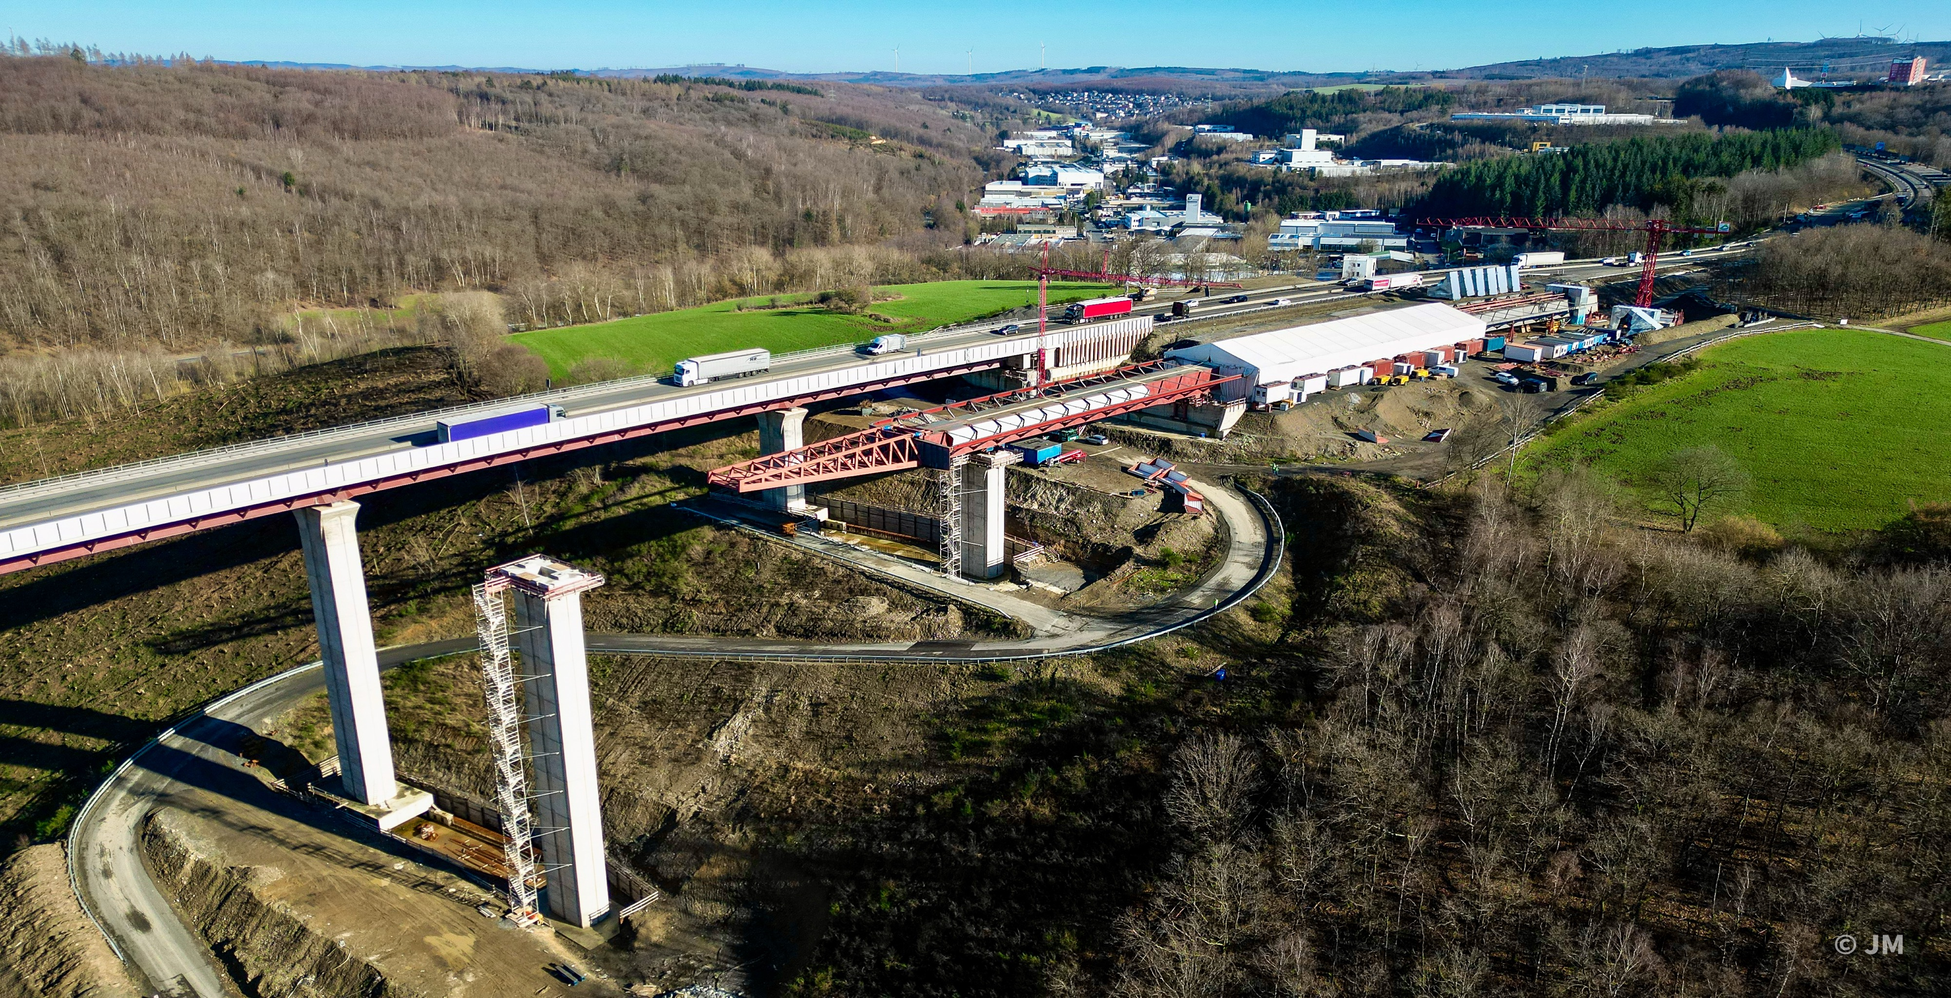
Steel structure and bridges
Jul 2022 – Jul 2023
BRIDGE RINSDORF
Construction of structural steel of bridge
Hutní montáže, a.s. carried out the steel structure assembly for a new bridge over the valley above Wilnsdorf on the E 41 in Germany. The project emphasized precision and safety, contributing to smoother traffic and the overall improvement of the city's transport infrastructure.
RINSDORF, GERMANY

Slide 32
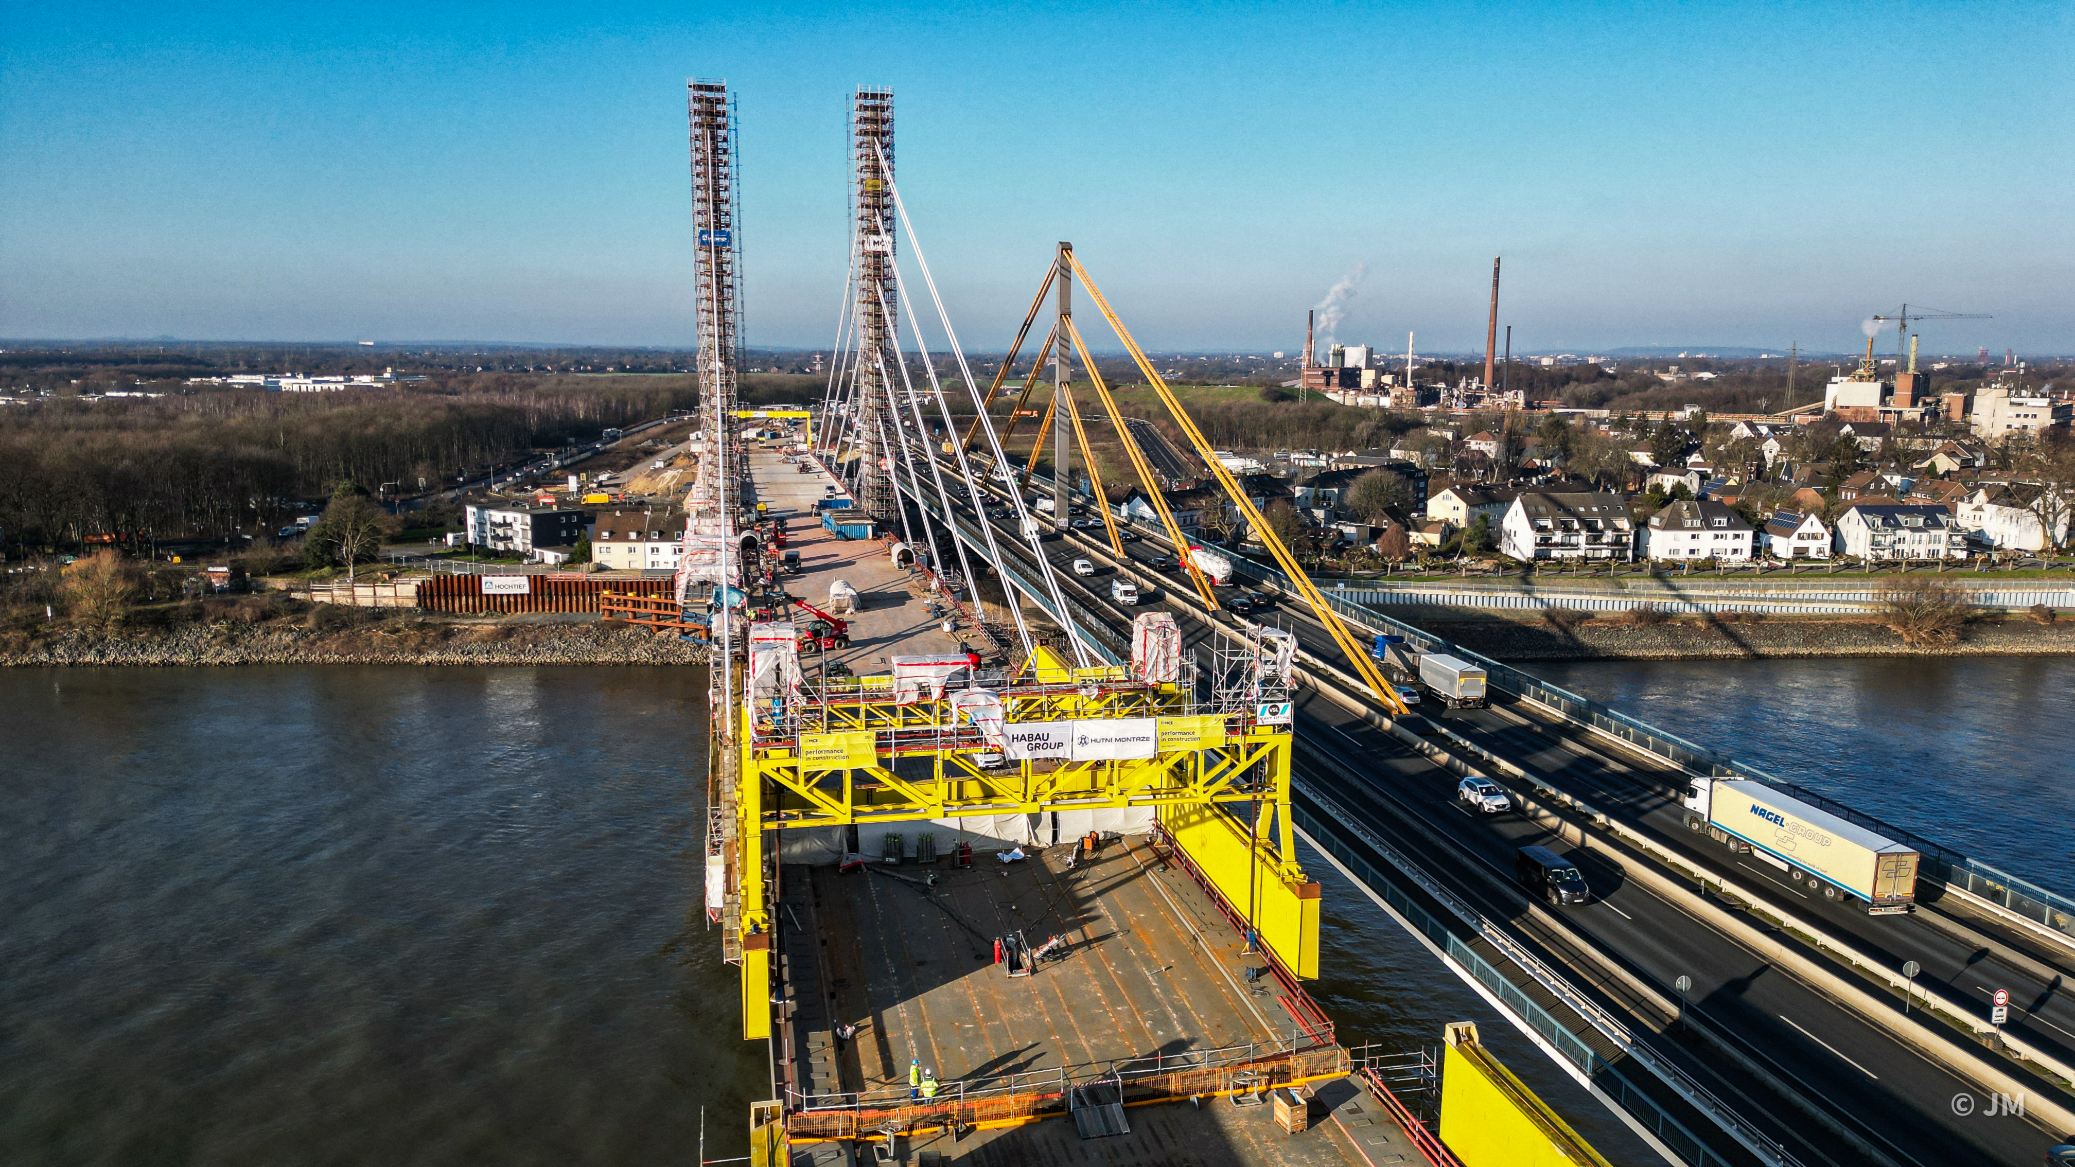
Steel structure and bridges
Jan 2021 – Jun 2023
BRIDGE DUISBURG A40
Construction of structural steel of bridge
Hutní montáže, a.s. was involved in the assembly of a new highway bridge on the A40 in Duisburg, Germany. The project included the installation of large steel structures, highlighting the company's expertise in heavy lifting and precision assembly. The bridge, designed to improve traffic flow in a busy urban area, was built under strict technical and safety standards.
DUISBURG, GERMANY

Slide 33
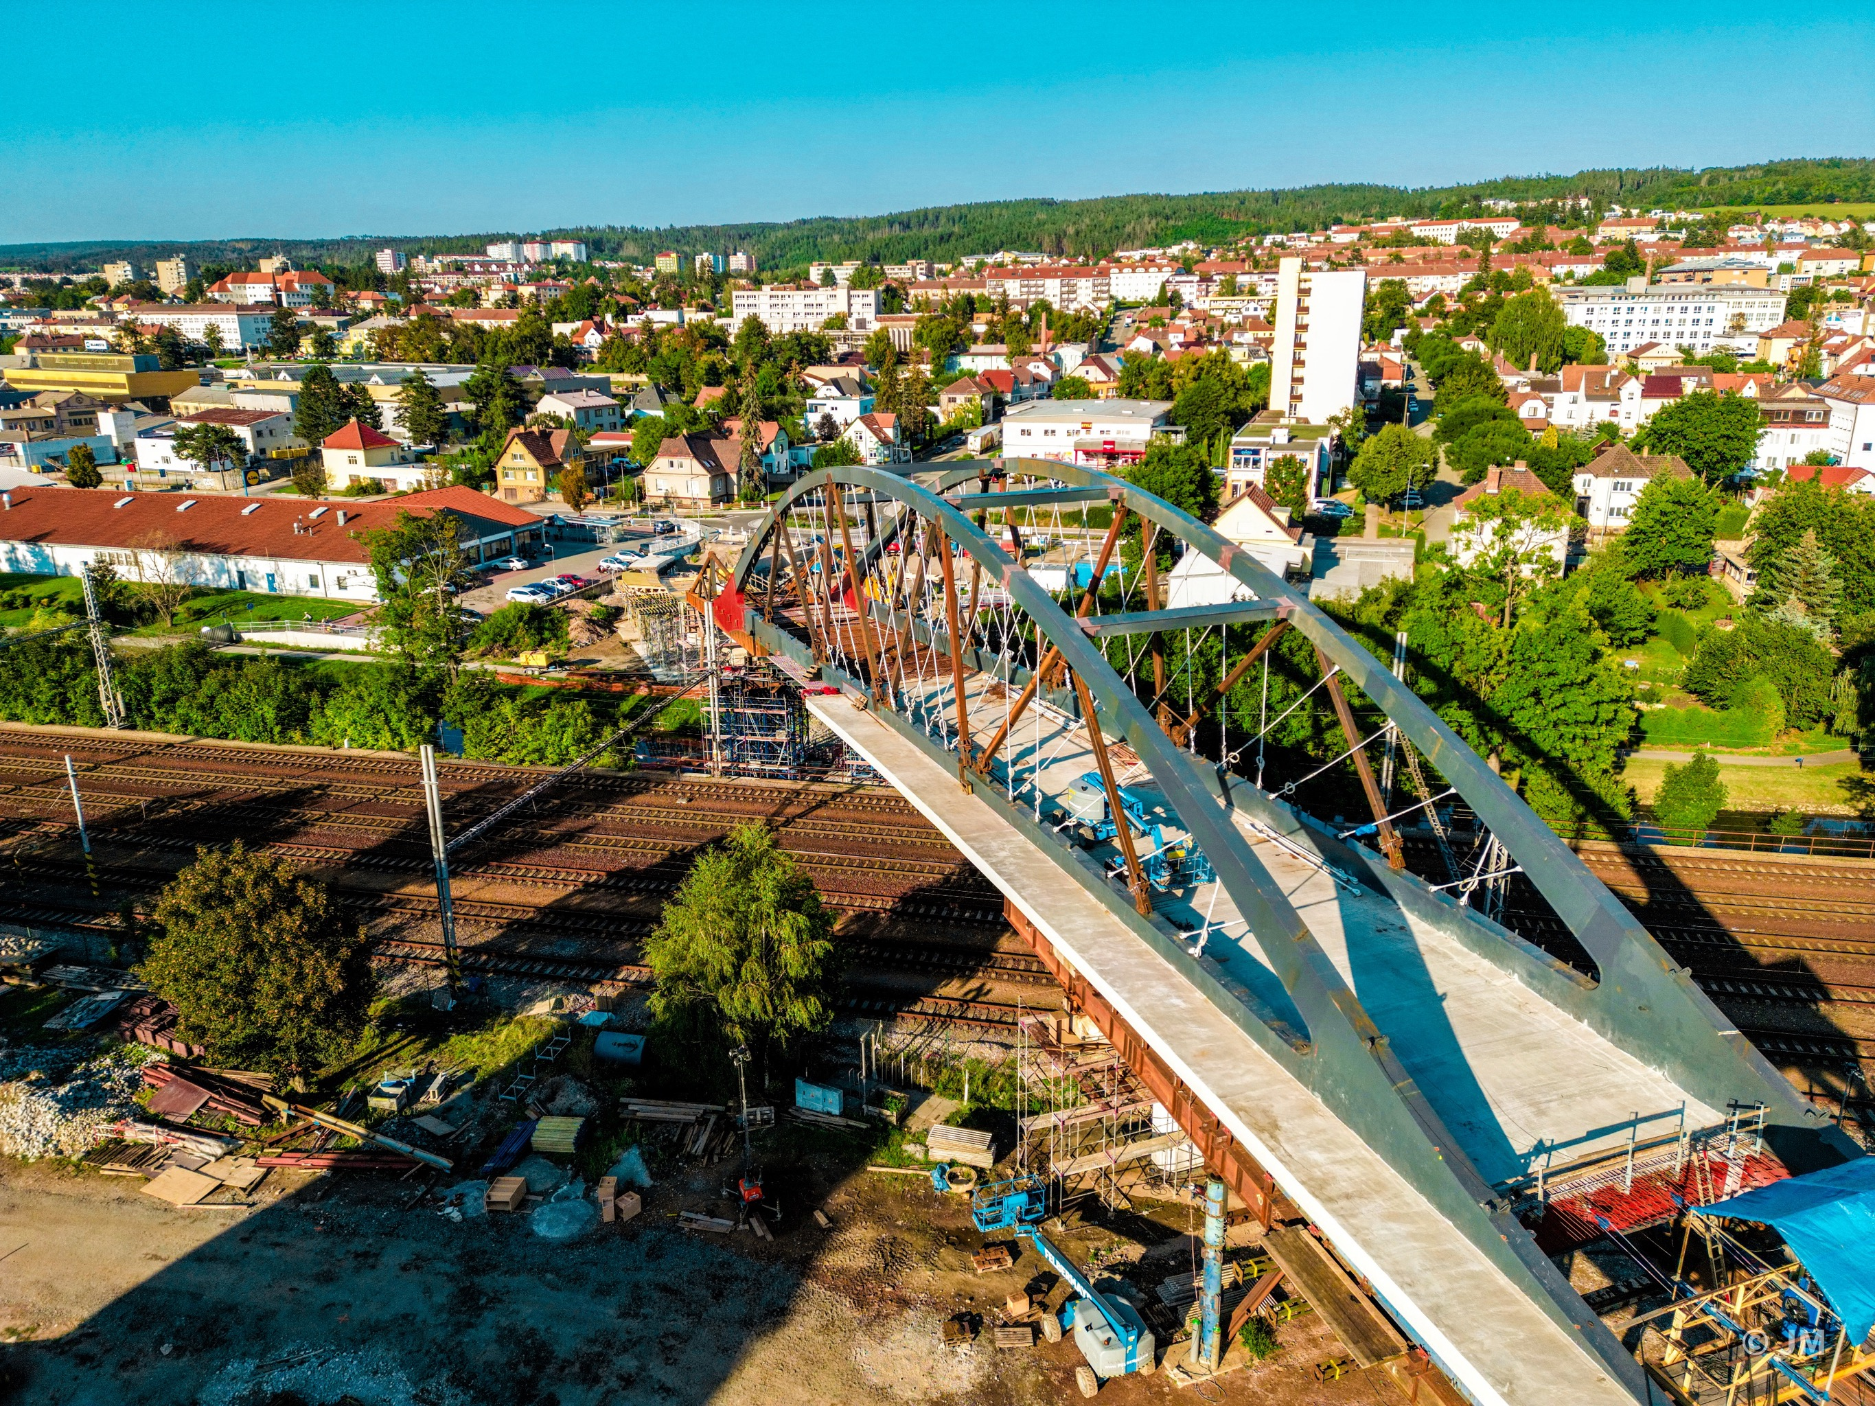
Steel structure and bridges
Jan 2022 – Oct 2022
BRIDGE BLANSKO
Construction of structural steel of bridge
Hutní montáže, a.s. carried out the steel structure assembly. The new road bridge, which spanned the railway line and the Svitava River, fulfilled a long-standing wish of local residents to connect two parts of the town, divided by the river and the railway line.The project emphasized precision and safety, contributing to smoother traffic and the overall improvement of the city's transport infrastructure.
BLANSKO, CZECH REPUBLIC

Slide 34
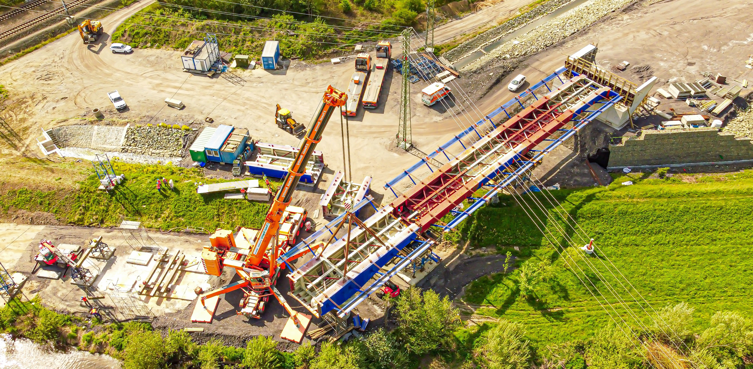
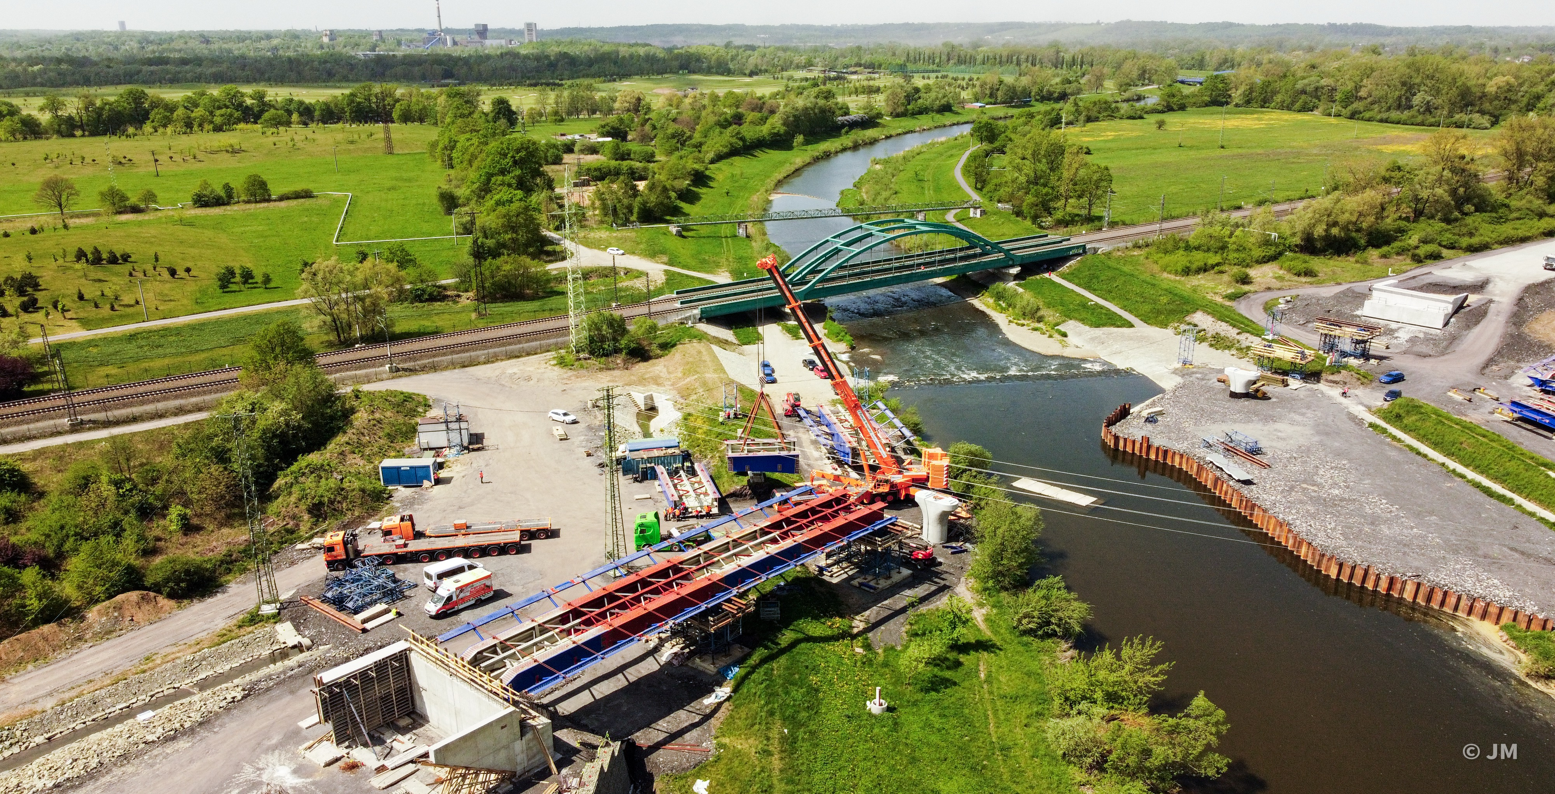
Steel structure and bridges
Jan 2022 – Oct 2022
BRIDGE KARVINÁ
Construction of structural steel of bridge
Hutní montáže, a.s. carried out the steel structure assembly for a new bridge in Karviná. The bridge over the Olše itself is a three-pole steel-concrete bridge with a total length of 180 metres, while the span of the main bridge span (over the river) is 70 metres. 820 tonnes of steel will be stored in the steel structure of the bridge. The project emphasized precision and safety, contributing to smoother traffic and the overall improvement of the city's transport infrastructure.
KARVINÁ, CZECH REPUBLIC

Slide 35
ONGOING AND RECENT PROJECTS
STEEL STRUCTURE ERECTION
Year | Title | Scope of supply | Customer | Location
01/2025 - 06/2025 | Bridge Ramfjordbrua | Preassemply structural steel of bridge | Metrostav DIZ | Szczecin, Poland
11/2024 - 04/2027 | Rheinbrücke Duisburg A 40 | Construction of structural steel of bridge | MCE GmbH | Duisburg, Germany
06/2024 - 09/2026 | Raderhochbrücke | Construction of structural steel of bridge | Plauen Stahl Technologie GmbH | Rendsburg, Germany
11/2023 - 10/2024 | Bridge Přerov | Construction of structural steel of bridge | DSC, a.s. | Czech Republic
11/2023 – 08/2024 | Bridge Spaghettiknoten Leverkusen | Construction of structural steel of bridge | ZSB Zwickauer Sonderstahlbau | Leverkusen, Germany
01/2023 – 05/2024 | Bridge Bad Kösen | Construction of structural steel of bridge | Plauen Stahl Technologie | Bad Kösen, Germany
07/2022 – 07/2023 | Talbrücke Rinsdorf BA2 | Construction of structural steel of bridge | ZSB Zwickauer Sonderstahlbau | Rinsdorf, Germany
01/2022 – 10/2022 | Bridge Blansko | Construction of structural steel of bridge | Metrostav, a.s. | Czech Republic
01/2021 –06/2023 | Rheinbrücke Duisburg A40 | Construction of structural steel of bridge | MCE GmbH | Duisburg, Germany
08/2020 –12/2024 | Bridge Pirna | Construction of structural steel of bridge | Metrostav a.s. | Pirna, Germany
12/2020 – 08/2022 | D48 – Frýdek-Místek bypass phase II | Erection of SO 222 and SO 217 bridges | STRABAG-EUROVIA Consortium | Czech Republic
11/2018 – 12/2021 | Talbrücke Bridge, Rinsdorf BA1 | Construction of structural steel of bridge | ZSB Zwickauer Sonderstahlbau | Germany
10/2018 – 10/2021 | Rheinbrücke Schierstein - Wiesbaden | Construction of structural steel of bridge | Plauen Stahl Technologie | Germany

Slide 36
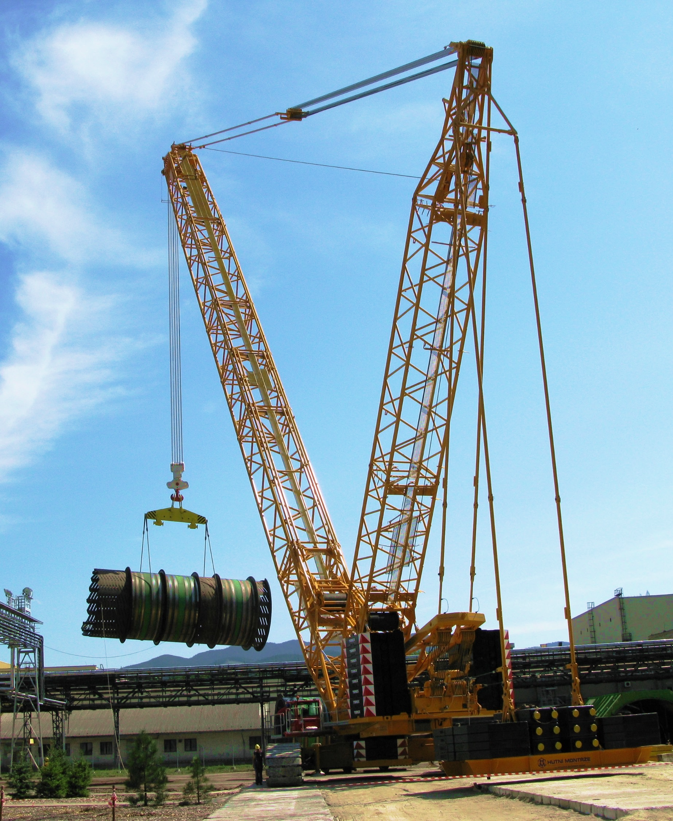
DIVISION OF
CRANES AND MACHINERY
Mobile crane, tower crane and derrick crane rental services
Transport and heavy hauling logistics
Heavy lifting solutions
AUTOCRANES WITH HYDRAULIC TELESCOPIC JIB |  | CRAWLER CRANES WITH LATTICE JIB
Crane type | Capacity | Crane type | Capacity | Capacity
DEMAG AC 615 | 200 t | DEMAG CC 600 | 140 t | 140 t
DEMAG AC 353 | 180 t | DEMAG CC 2400 | 350 t | 350 t
DEMAG AC 120 | 120 t | DEMAG CC 2800 | 600 t | 600 t
DEMAG AC 100 | 100 t | Derric and gantry cranes
DEMAG AC 205 | 80 t | HM 1000 D | 125 t
DEMAG AC 60 | 60 t | HM 1000 D | 125 t
DEMAG AC 40 | 40 t
DEMAG AC 30 | 30 t

Slide 37
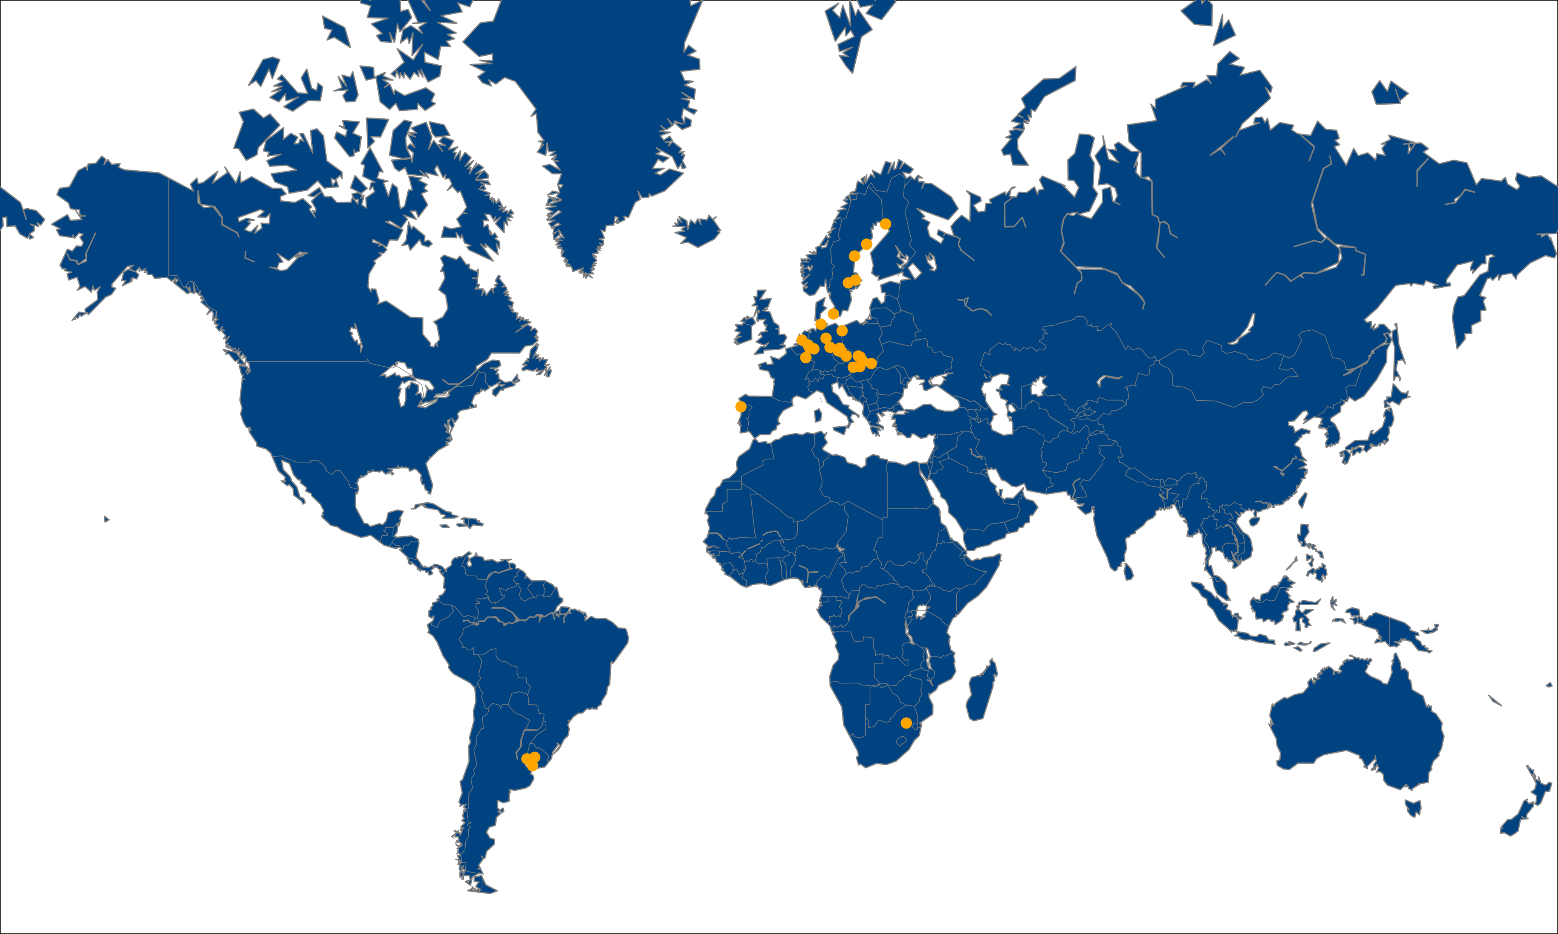
HUTNÍ MONTÁŽE WORLDWIDE

Slide 38

FOR CONTACT INFORMATION SCAN QR CODE:

Slide 39

member of GEOSAN INVESTIČNÍ

